Slide 1


Learning Short:
Community Engagement Studio
Kristin I. Miller
January 2026

Slide 2

ACKNOWLEDGEMENTS
Community Engagement Studio Toolkit 2.0
The Community Engagement Studio model was developed and refined by the following people:
  Tiffany Israel, MSSW
    Vanderbilt University Medical Center
  Helena Farrow, MPS
    Nashville OIC
  Yvonne Joosten, MPH
    Vanderbilt University Medical Center
  Yolanda Vaughn, MS
    Neighborhoods Resource Center
Meharry-Vanderbilt Community Engaged Research Core
Vanderbilt Institute for Clinical and Translational Research
Sponsor Award # 3-UL1-RR025747-0251, UL1 RR024975 and UL1-TR000445
NCRR/NIH
For more information, go to
http://victr.vanderbilt.edu/pub/community/ or
Email cerc@vanderbilt.edu

Slide 3
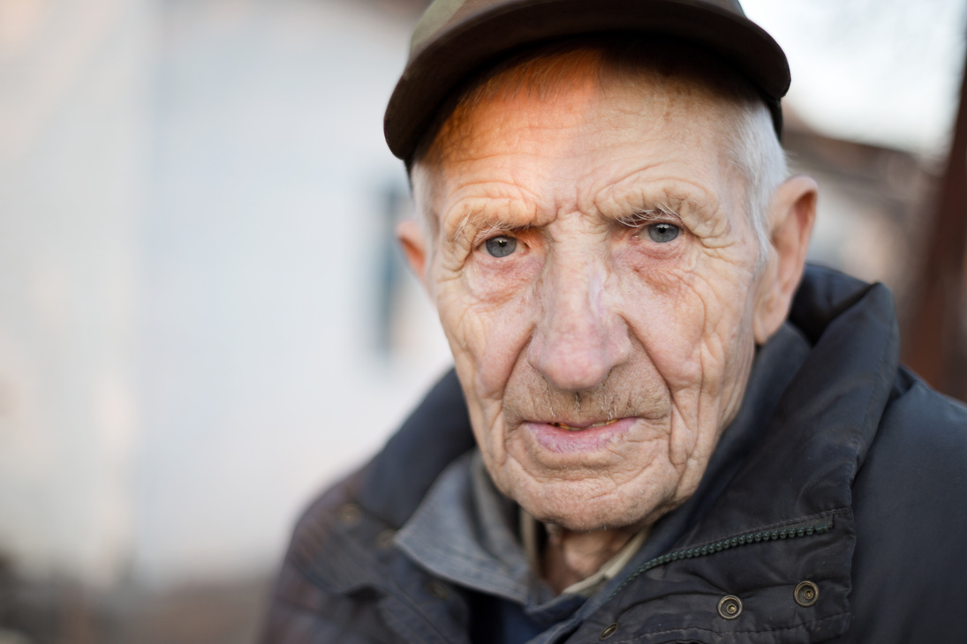
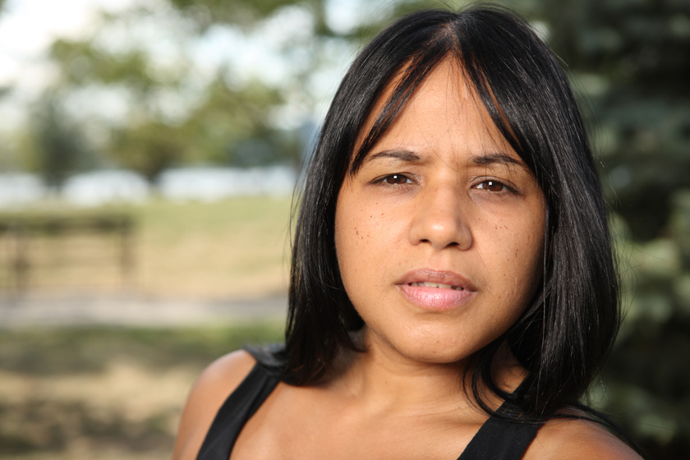
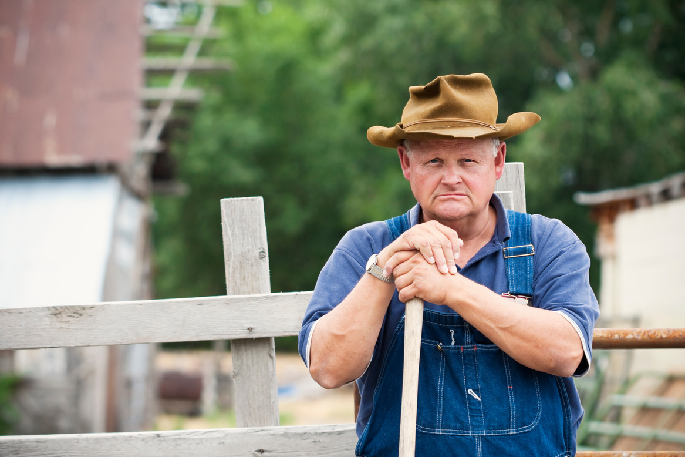
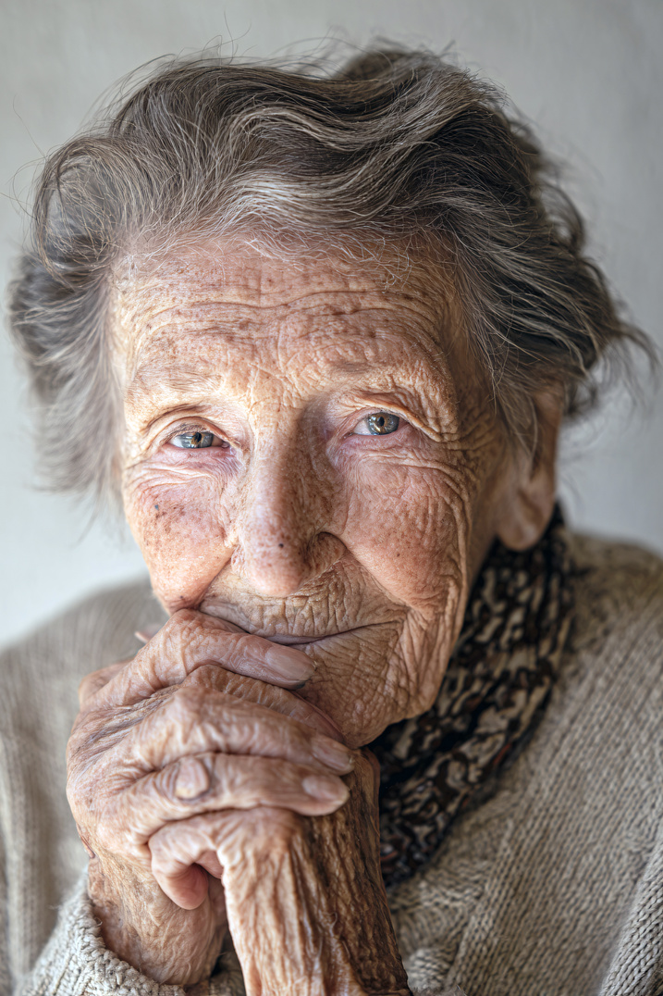
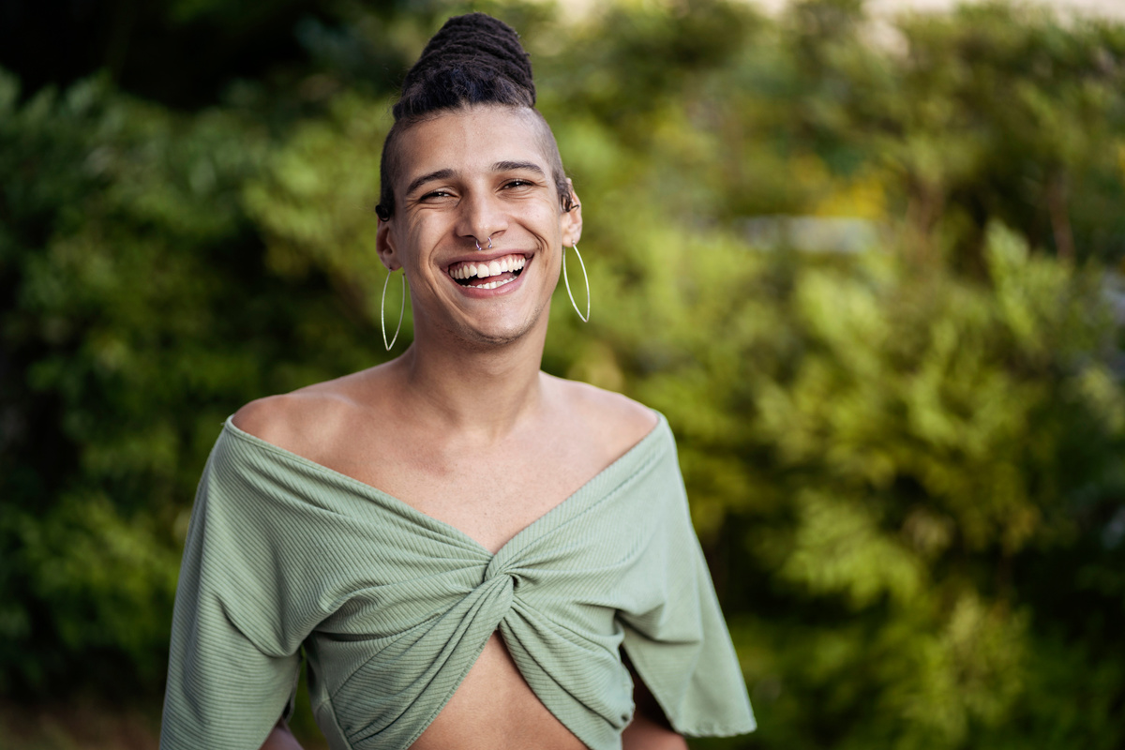
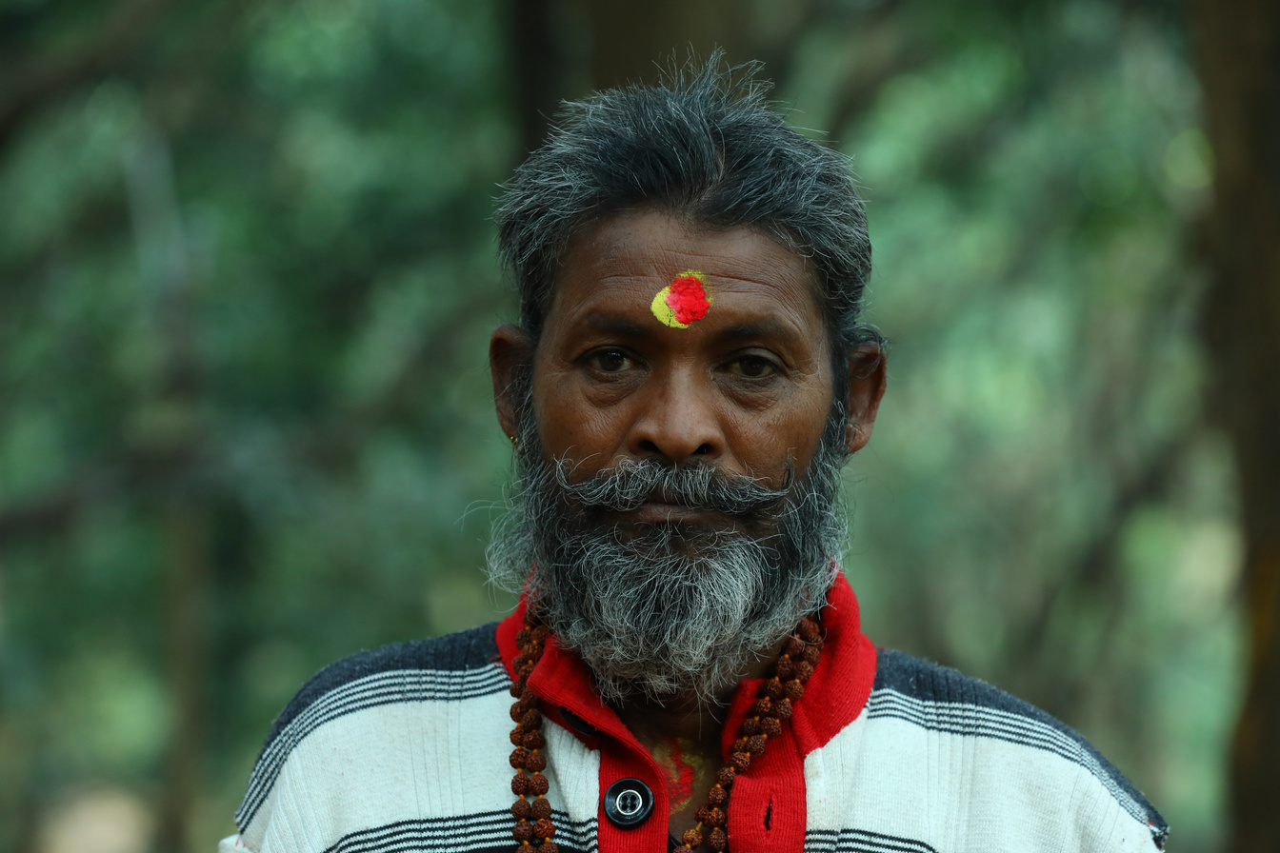

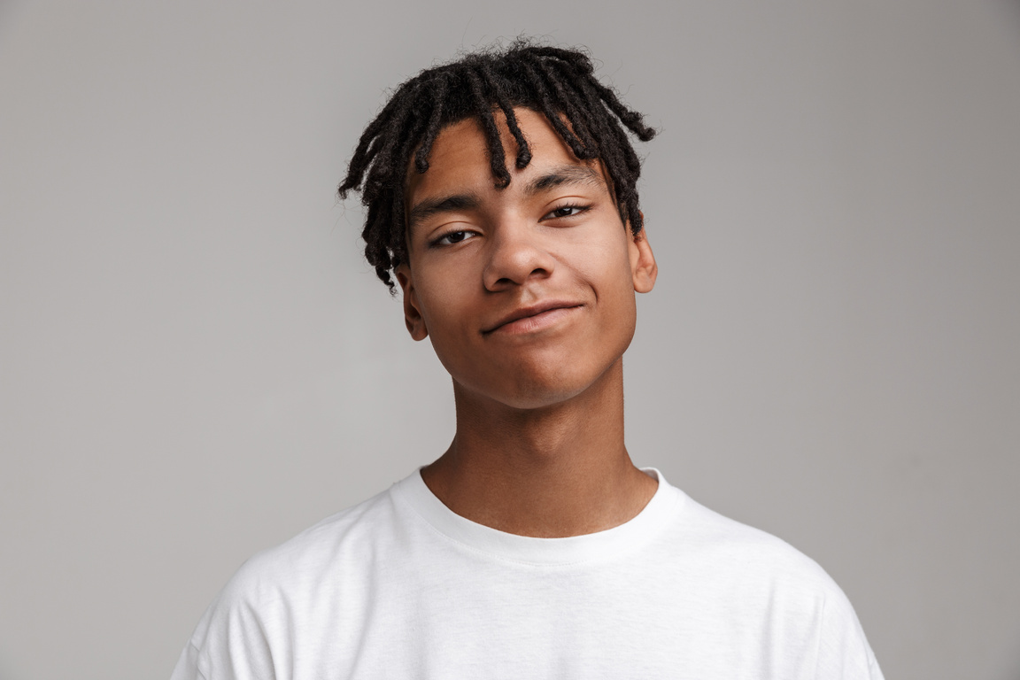
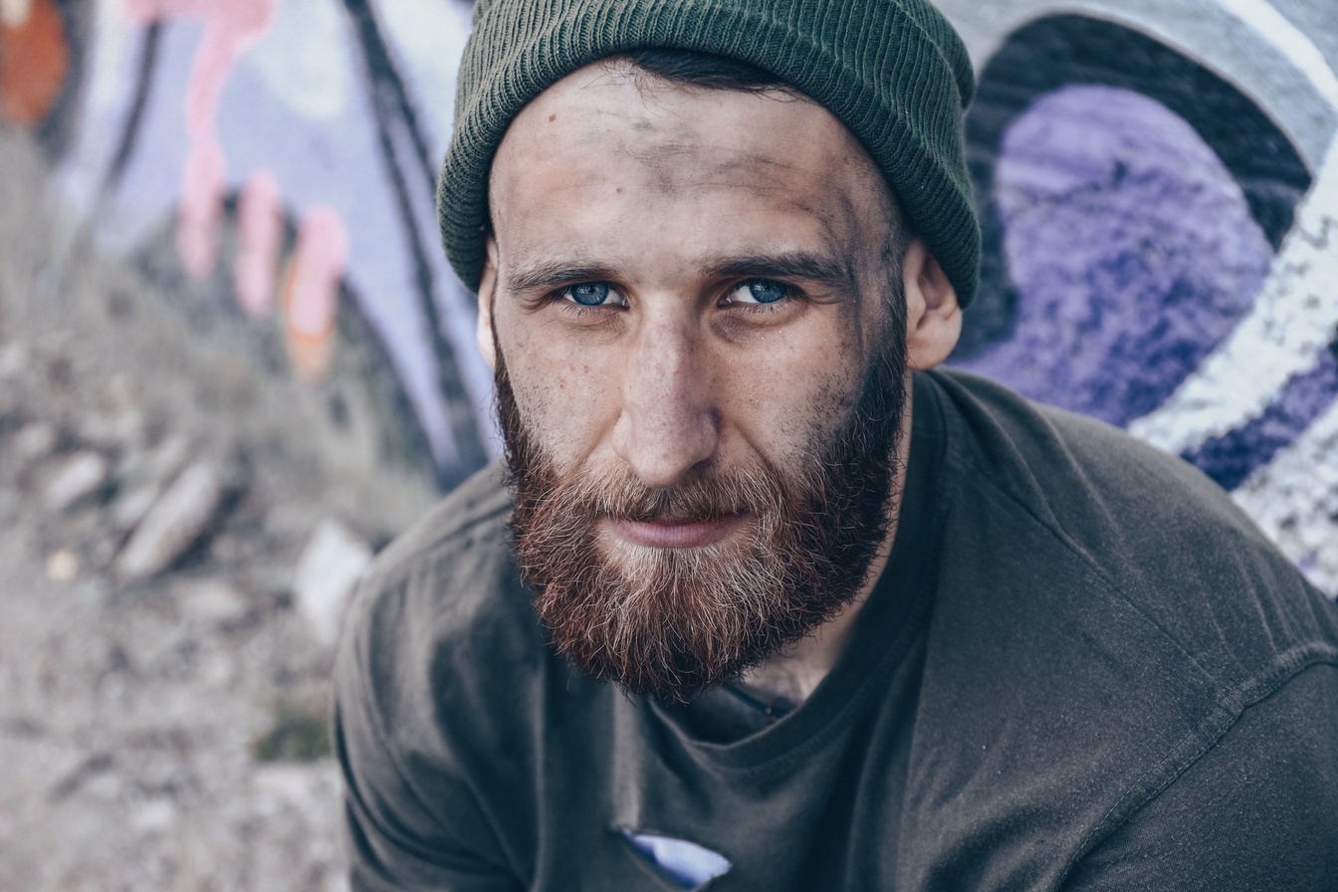

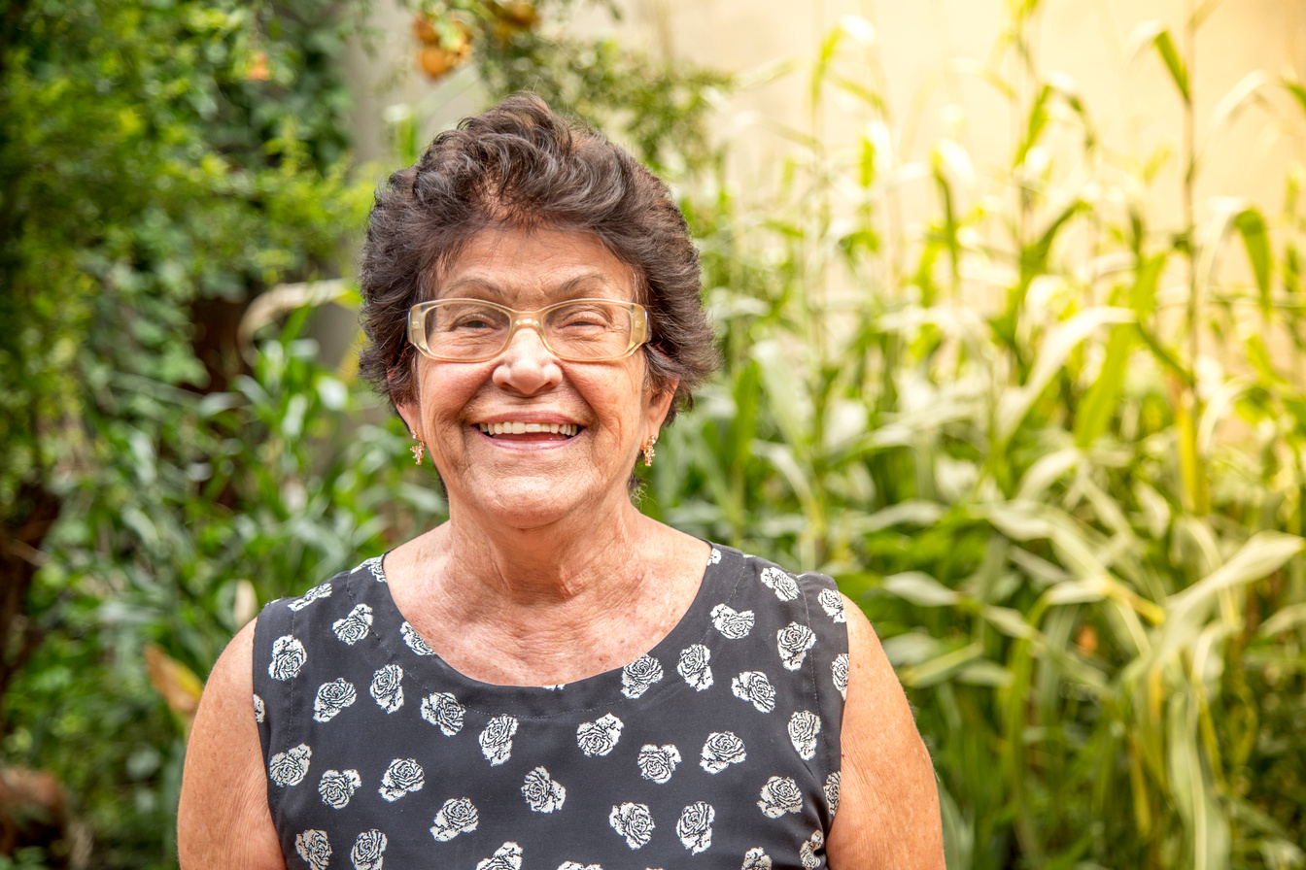
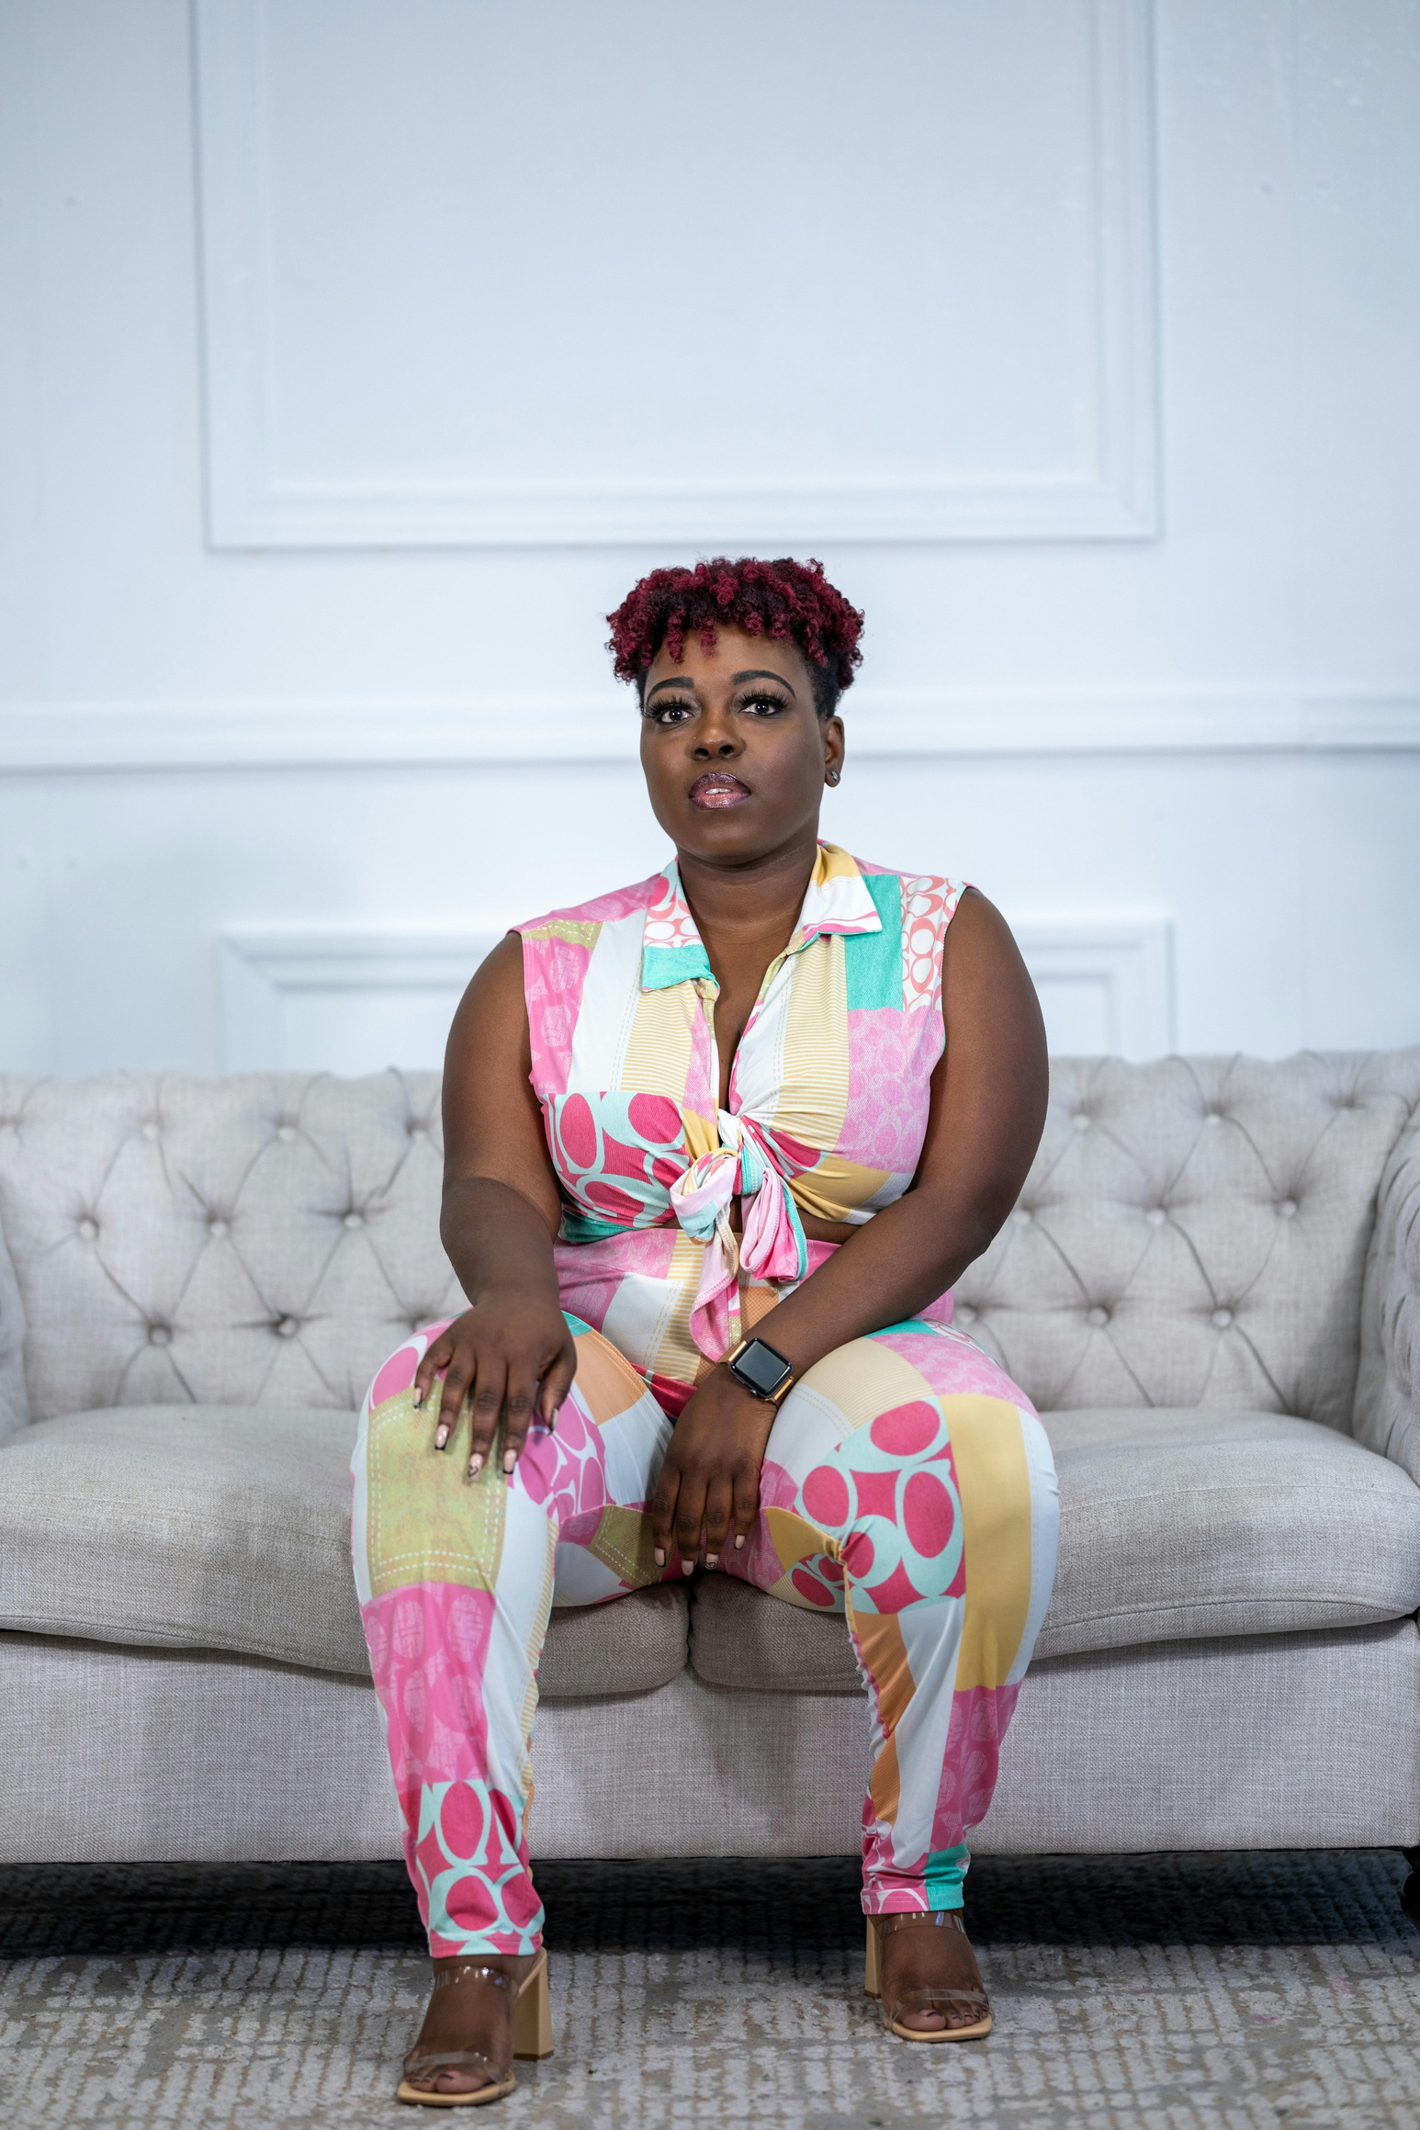
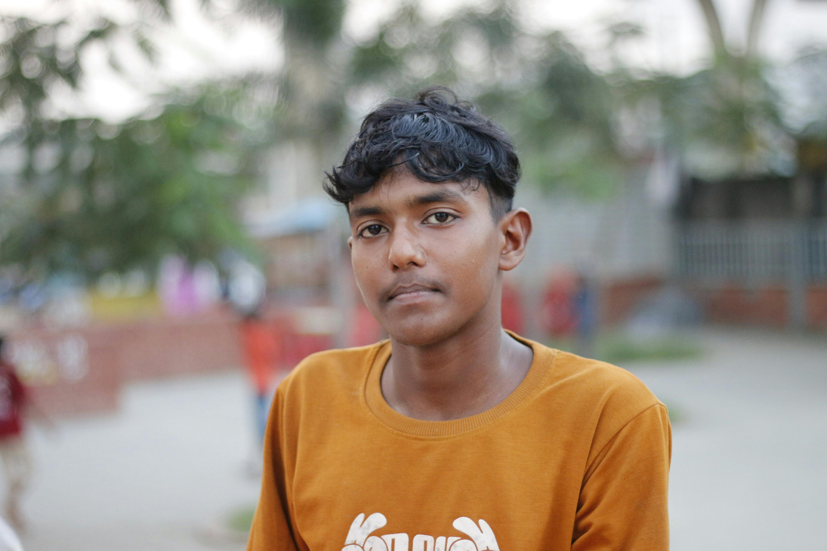
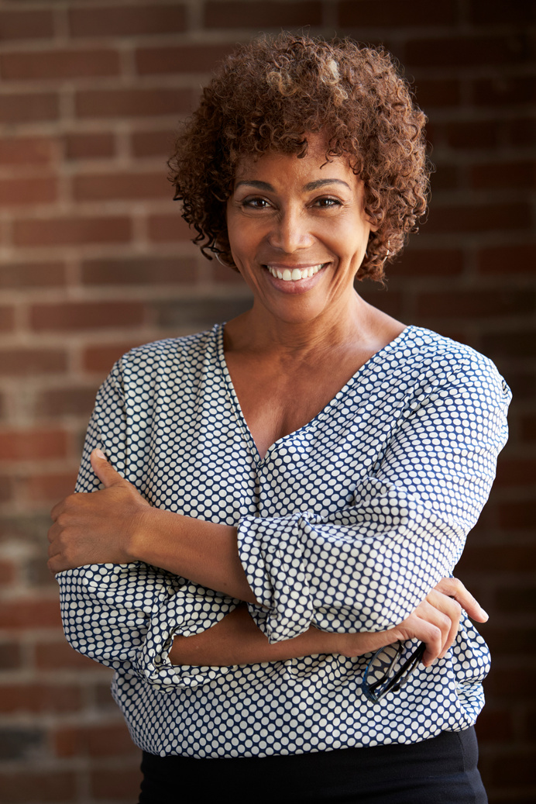
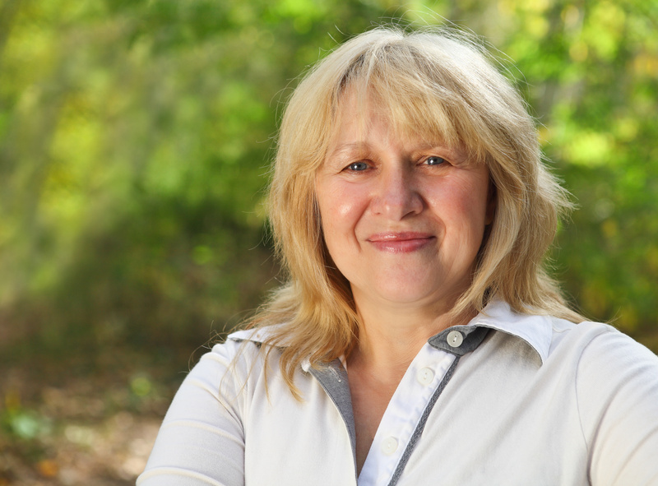
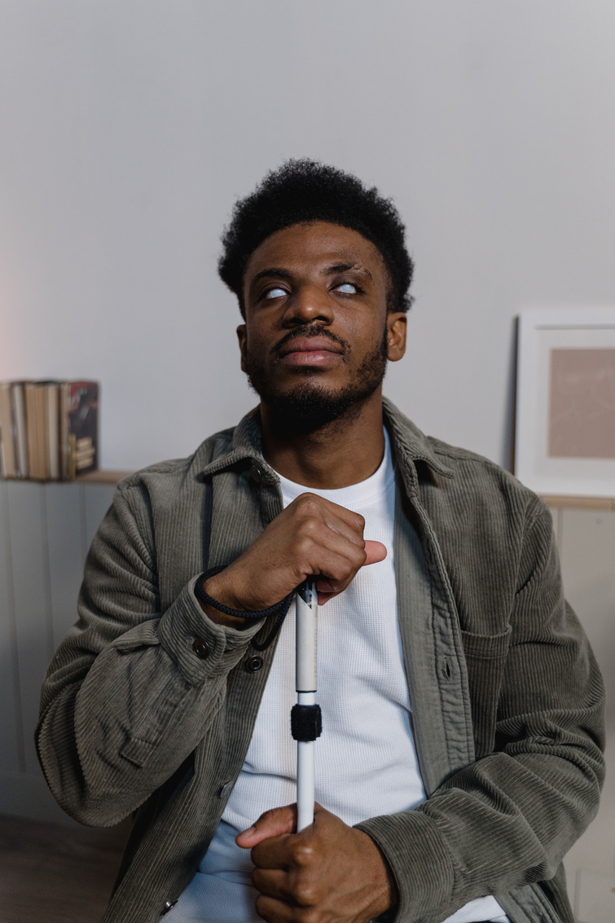
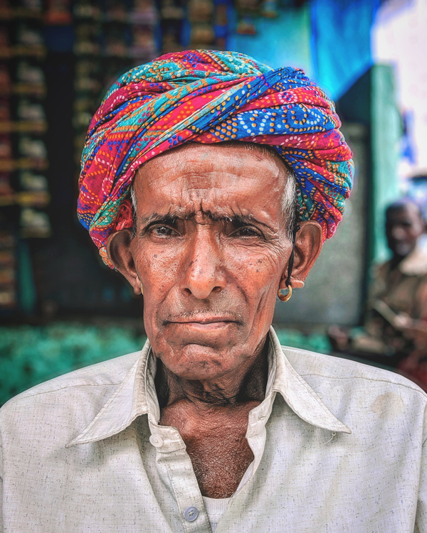

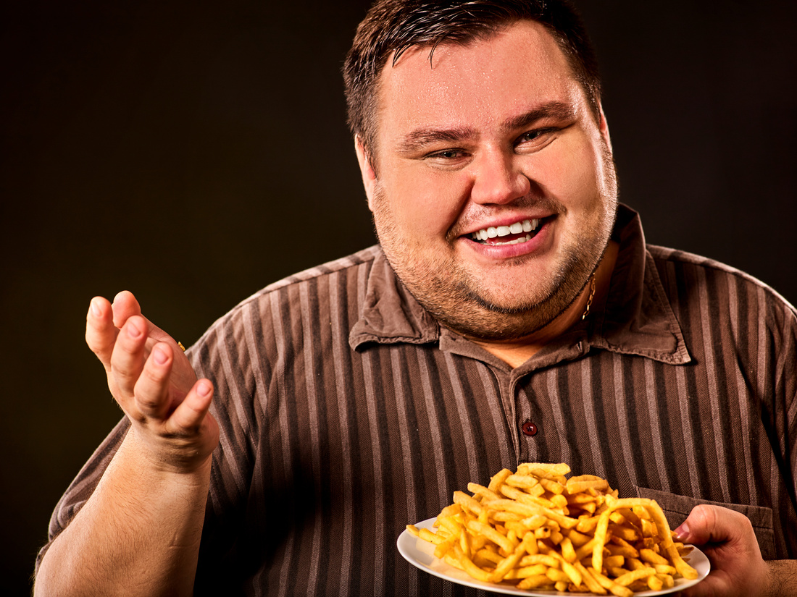
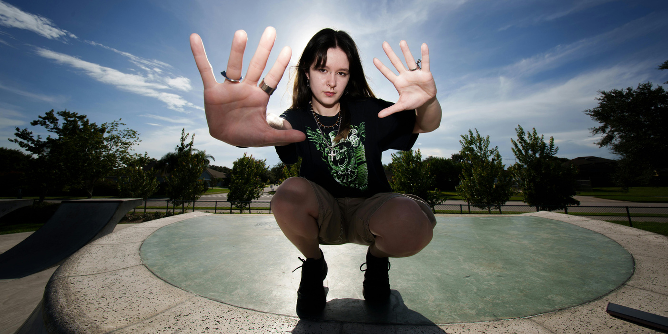
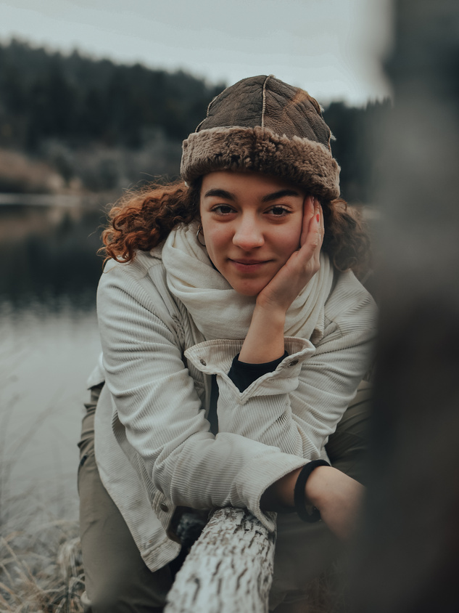
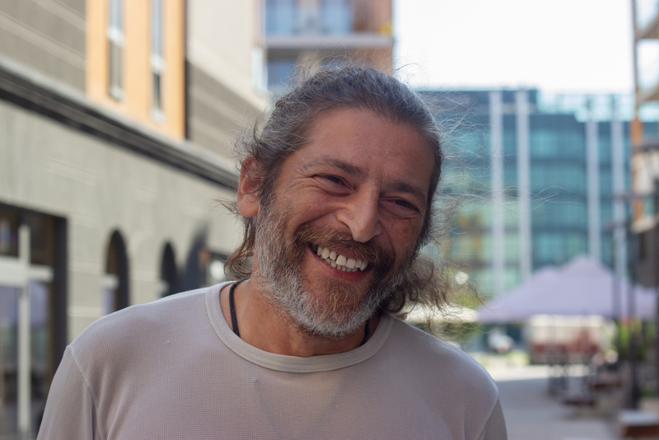

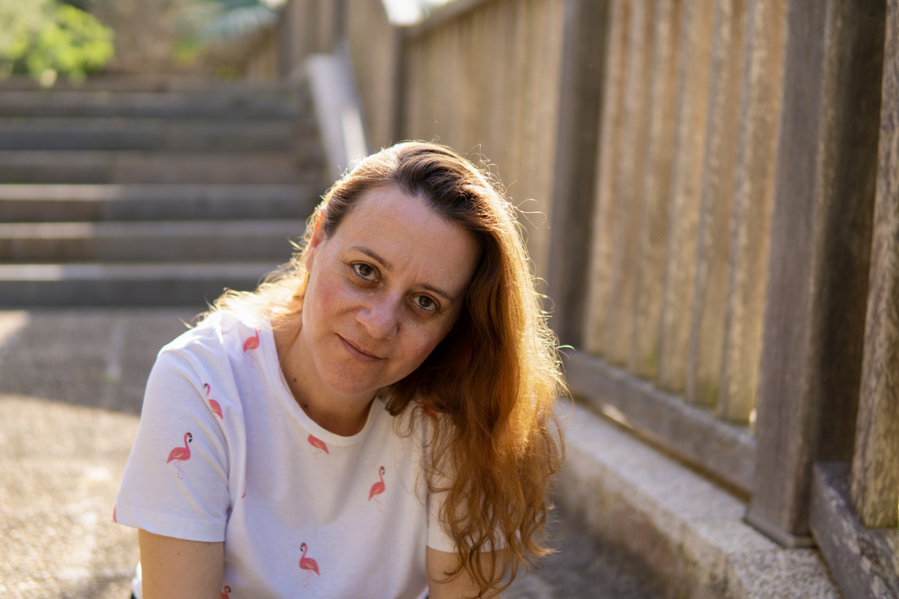

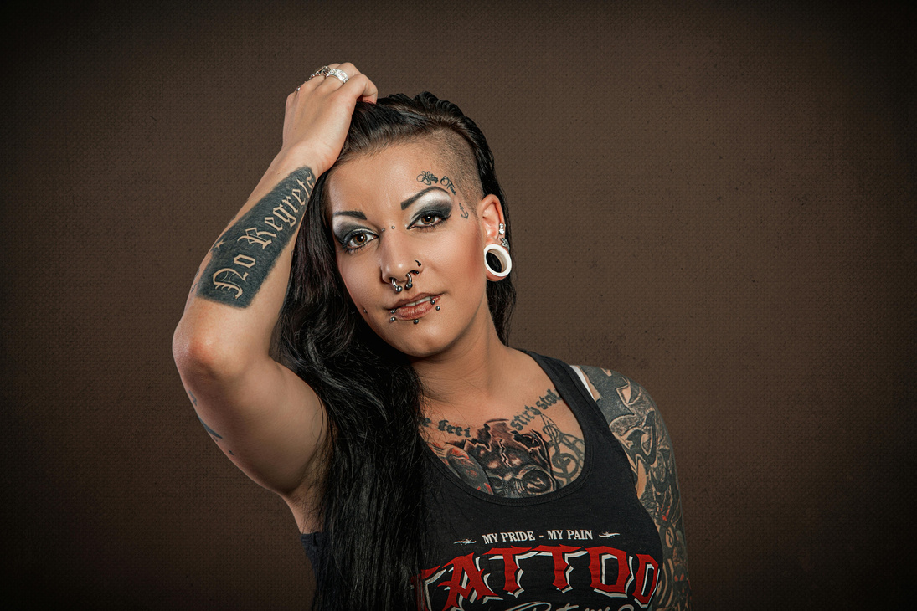
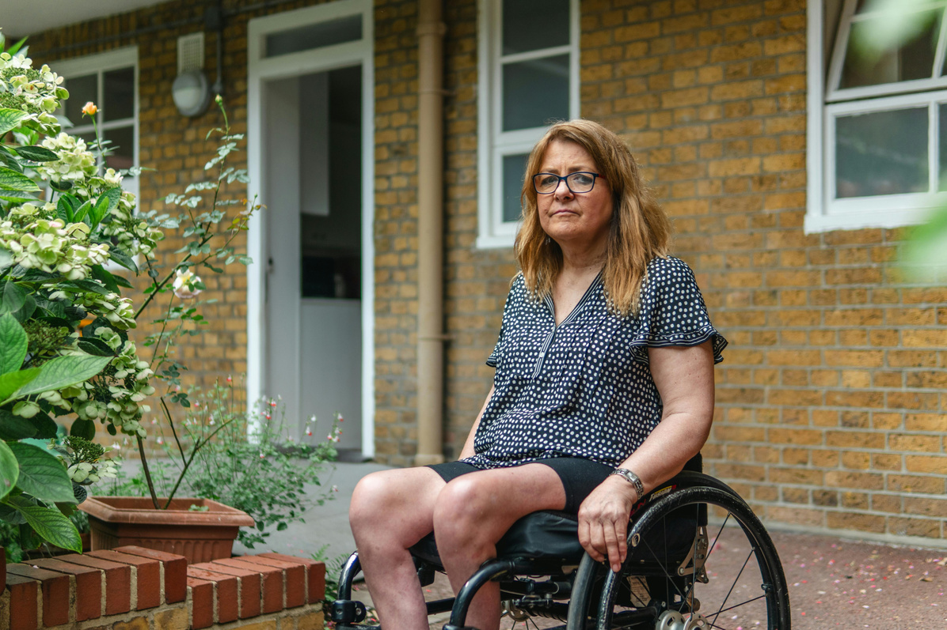
Community members at the research table improve the research!
A group of diverse people bring a mixture of experiences and a variety of perspectives.
Involving community members in the research process may not only be an ethical imperative, but also a scientific one. *
* Https://politicalsciencenow.com/for-better-science-the-benefits-of -community-engagement-in-research/

Slide 4

WHY HAVE A COMMUNITY ENGAGEMENT STUDIO?
It improves research
  It ensures research is applicable to real world problems
  The research is more patient-centered
  It improves the understanding of research for patients, their family and community members in general

Slide 5
WHO CAN PARTICIPATE IN A STUDIO?
EVERYONE!

Slide 6
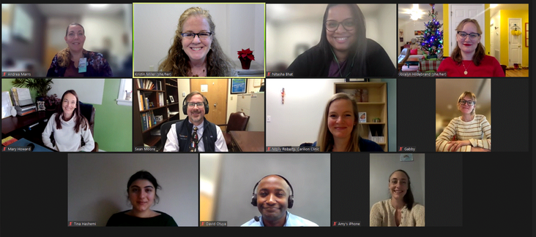
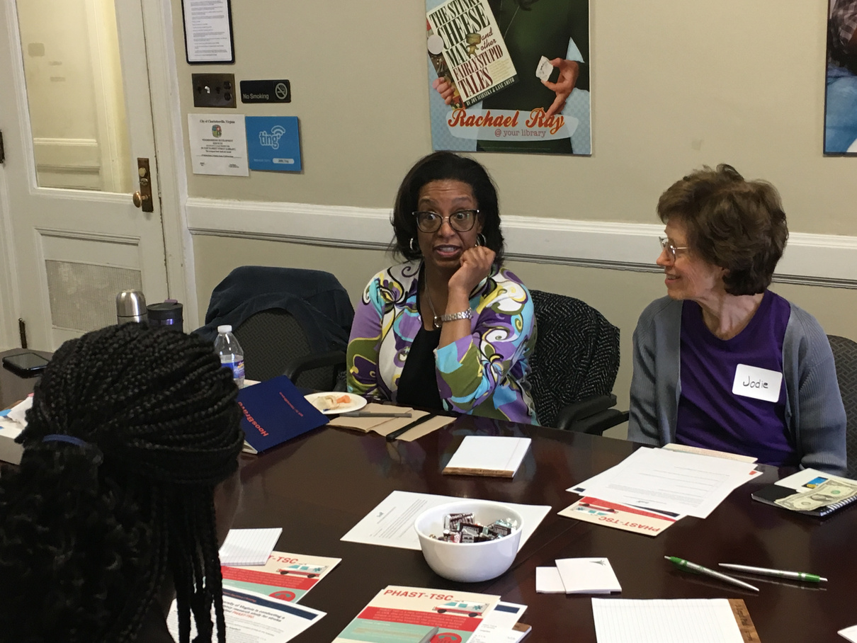

WHAT IS A COMMUNITY ENGAGEMENT STUDIO?
Generally, it is a facilitated conversation between researchers and community members.
Trans Nasal Endomicroscopy (TNE)Researcher/Leading Physician: Sean Moore, MD (Division Chief)
Department: Pediatric Gastroenterology (GI), Hepatology, & Nutrition
University of Virginia (UVA) December 7, 2022
A community engagement is not:
Clinical Research
Community Based Participatory Research
Advisory Board
Recruiting Tool
Focus Group

Slide 7
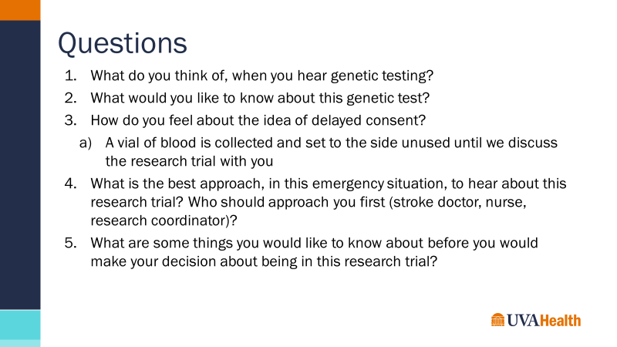
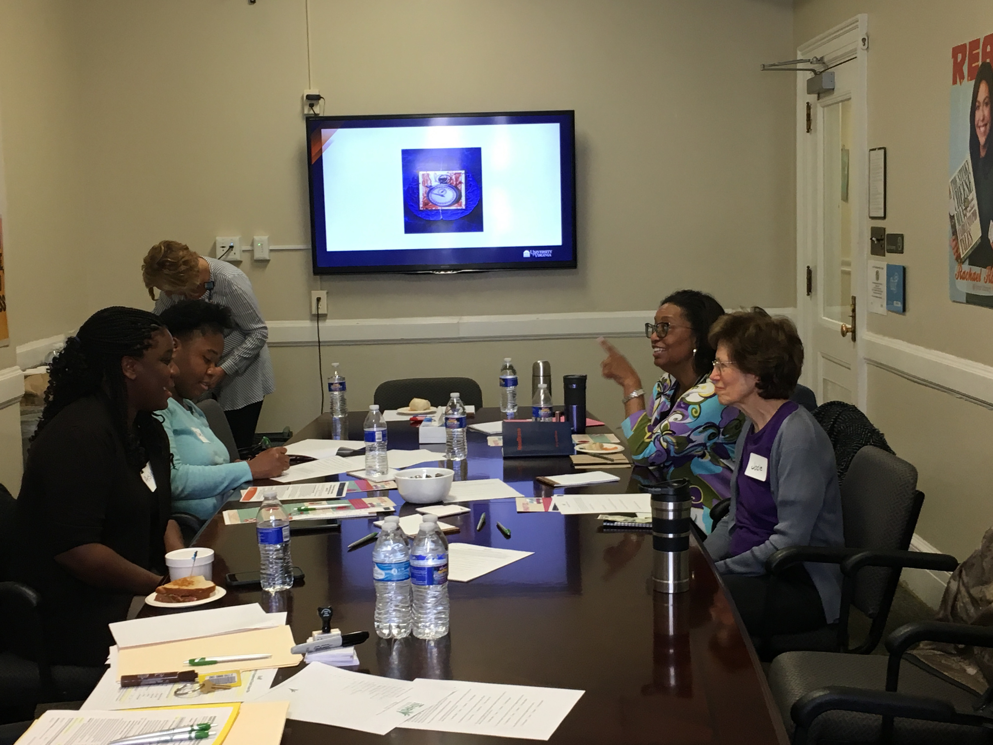
MORE ABOUT THE COMMUNITY ENGAGEMENT STUDIO
Specifically
  The researchers present their research project and the asks 3-5 questions of the community members
  They take place in person or by zoom
  Participants are paid for their time and expertise
  Studios last for about 1 ½ hours
Slide from the following Studio:
Implementation of Onsite Rapid CYP2C19 Assay for Genotype Guided Dual Antiplatelet Therapy

Slide 8
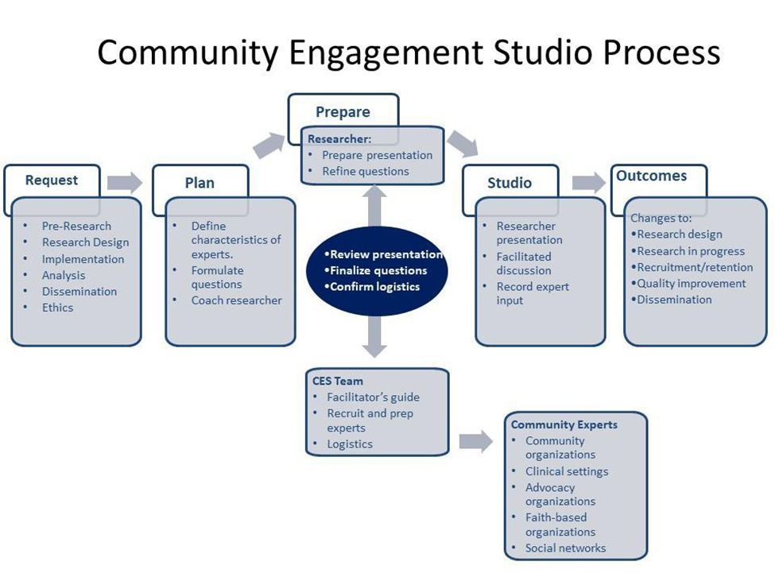
COMMUNITY ENGAGEMENT STUDIO PROCESS
Graphic from
Community Engagement Studio Toolkit 2.0

Slide 9
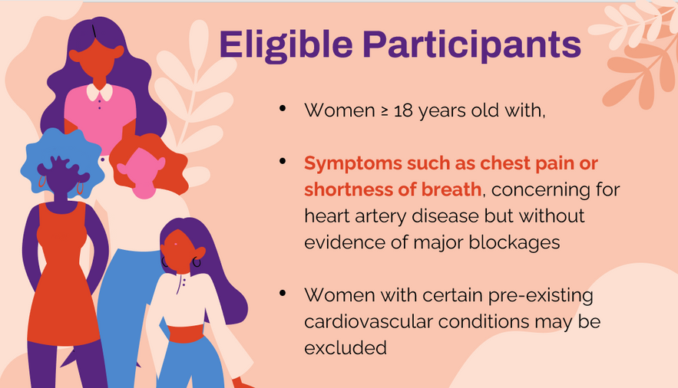
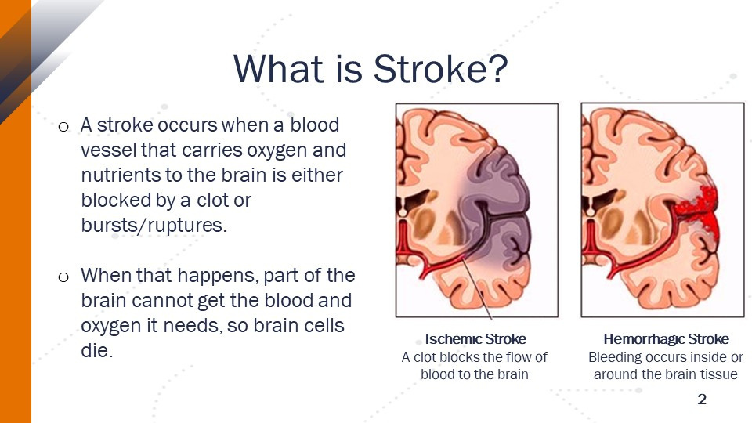
EXAMPLE SLIDES FROM PRESENTATIONS

Slide 10
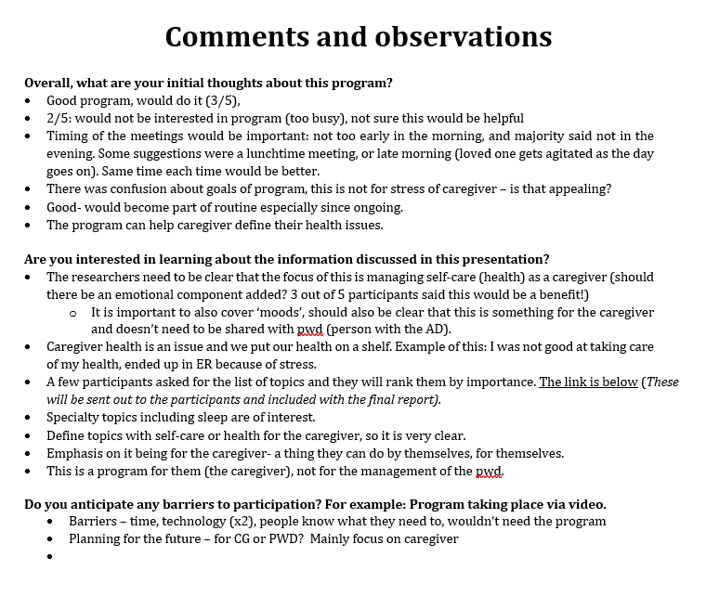
FINAL REPORT WITH FEEDBACK/RECOMMENDATIONS
  The final report with feedback is given to researchers and community participants
  Evaluation questions the following in addition to the specific questions in the presentation
    General thoughts about the project
    What was good about the project?
    What challenges do you think the project will have in the community?
    What would you like to see the researcher do differently?

Slide 11
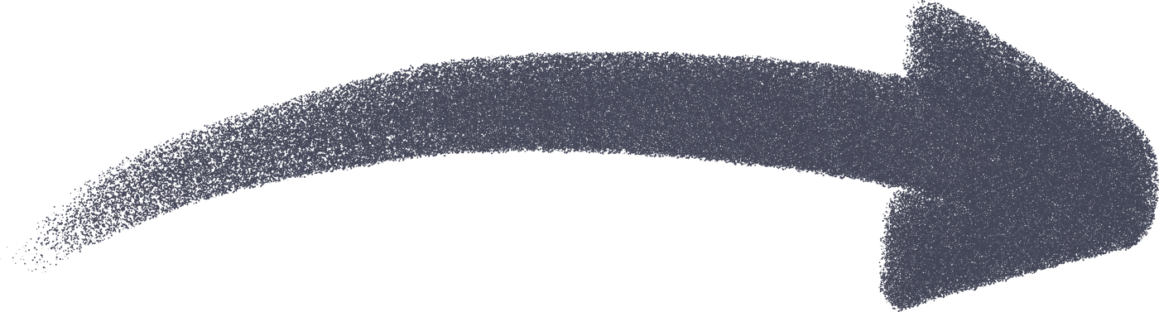
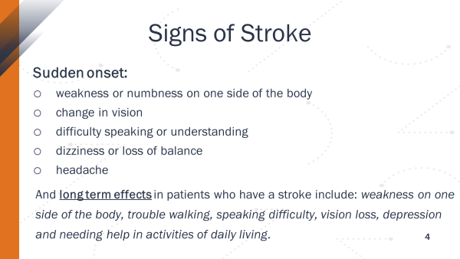
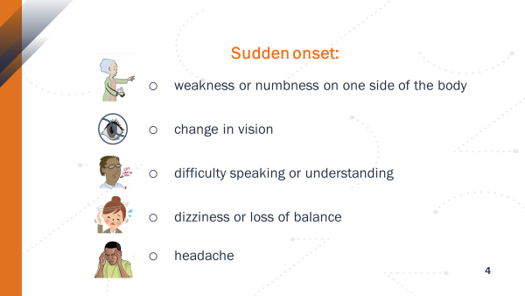

OPERATIONALIZING THE RECOMMENDATIONS
Community Input: Signs of stroke slide need more illustrations...

Slide 12
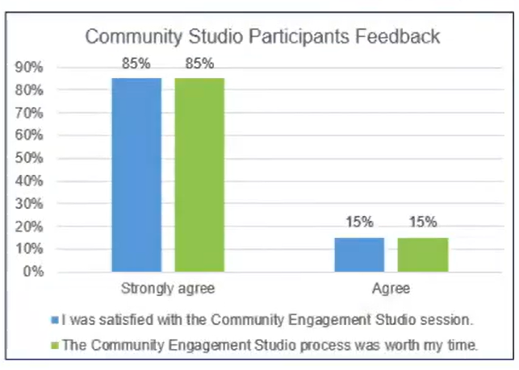
WHAT DO PEOPLE THINK OF THEIR EXPERIENCE?
Community Participant quote: “It was a great experience to voice concerns and special considerations on behalf of community members and to feel heard”.
Research Participant quote: “I learned a lot and I am sure we will use the process again in the future”.
Research Participant quote: “We’ll absolutely incorporate feedback from the session into our program development”.

Slide 13
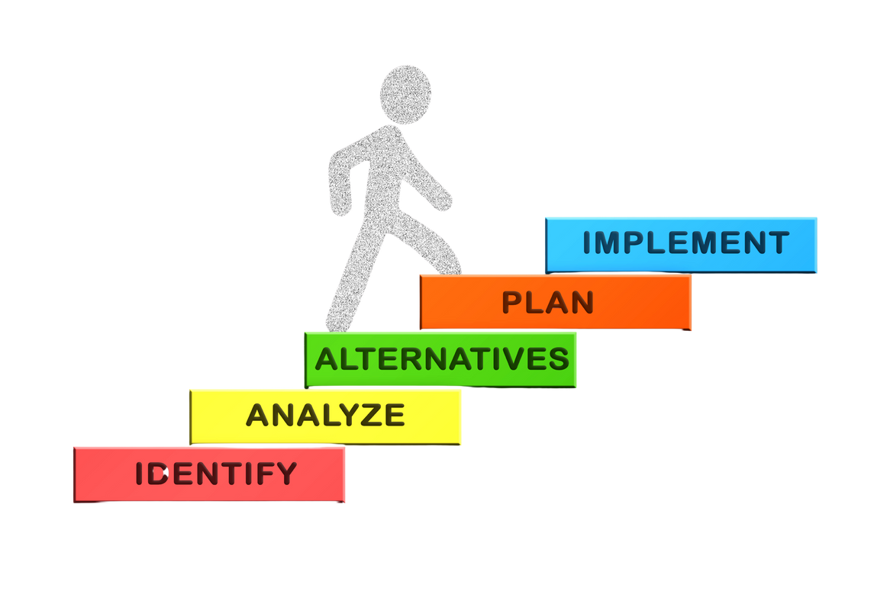
LESSONS LEARNED-
QUESTIONS TO ASK BEFORE PLANNING A STUDIO
  How can the team ensure we’re not just reaching community members, but reaching the full range of people with lived experience whose perspectives are important to our project?
  While technology can improve connectivity, would it be better to do this in-person, or maybe even hybrid?
  Are we aware of needed accessibilities and prepared to provide extra tools to people who might need it?
  What are the specific barriers that the target audience may experience?
Consider them during the planning stage to enable effective mitigation.

Slide 14
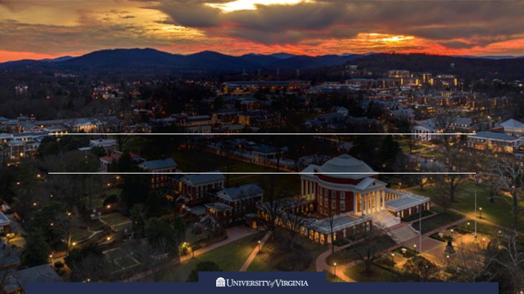
THANK YOU!
Contact Kristin I. Miller
at kim6g@uvahealth.org for information

