Slide 1

INTEGRATING Prerequisite Concepts into the Current Course to Increase Equity & Inclusivity
Meiqin Li
May 1st, 2024

Slide 2

Prerequisite Skills:
A deficiency in prerequisite skills poses obstacles to student achievement, e.g.
reduced confidence
increased study time
difficulty understanding concepts
2. Offering dedicated prerequisite courses may not be feasible due to various factors, e.g.
delayed graduation
financial issues
already taken it

Slide 3
Presentation Objective:
Present a practical way - mastery-based approach, to create “equitable preparation” of the prerequisite skills for the current course that could be applied to many subjects, by taking calculus class for example (incorporating precalculus skills into Calculus II).

Slide 4
Strategy (Take-Away):
Step 1: Create the list of learning targets for prerequisite skills.
Step 2: Create multiple different but comparable versions of assessments for prerequisite skills that are aligned with the learning targets.
Step 3: Assign one version as the “learning version” and the other versions as “assessments”.
Step 4: Students take the assessments with multiple attempts till reaching the threshold passing line.

Slide 5
Title for 3-column Bullets Slide – Hidden
Step 1: Create the list of learning targets for prerequisite skills.
Analyze the prerequisite skills required for the current course.
Compile a list of learning objectives (<=25) corresponding to these prerequisites.
This list is accessible to all students.
e.g.
Learning objectives of Precalculus:
simplify expressions
apply Laws of Logs
determine limits
…

Slide 6
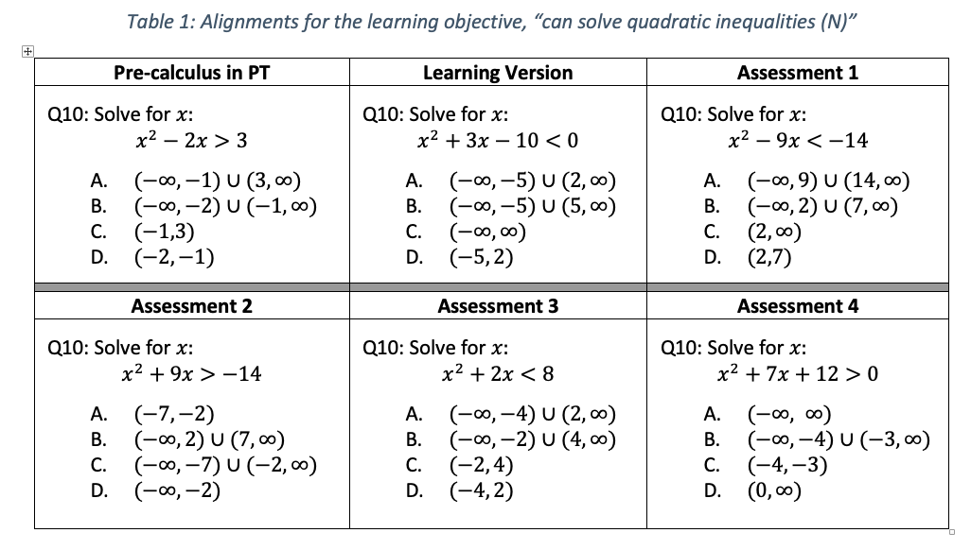
Title for 3-column Bullets Slide – Hidden
Step 2: Create multiple different but comparable versions of assessments.
Determine the type of questions according to the specific course (free-response, MCP, etc.)
Create multiple different but comparable versions of comprehensive assessments for prerequisite skills that are aligned with the learning targets
The example of precalculus is displayed in the right table. We created multiple versions with 30 MCP in each.

Slide 7
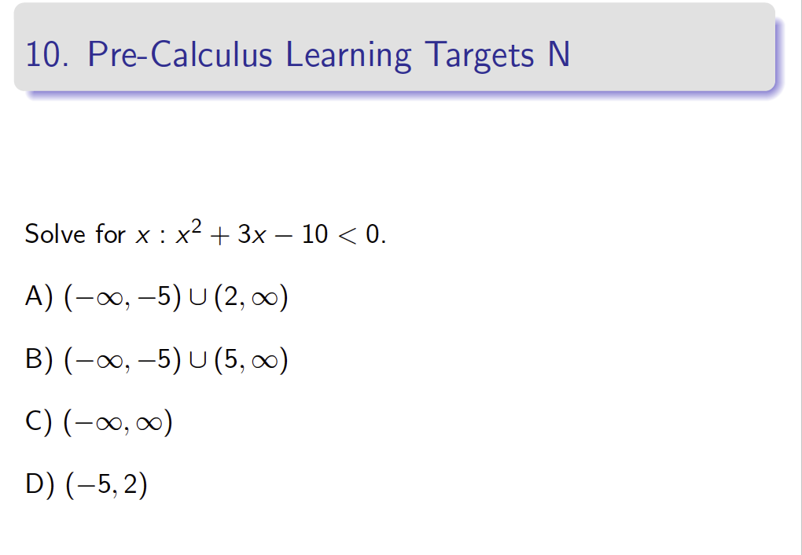
Title for 3-column Bullets Slide – Hidden
Step 3: Assign one version as the “learning version” and the other versions as “assessments”.
Assign one of the assessments to be the “Learning Version” (LV) and the other versions as “assessments”.
Each class, by displaying one or two question(s) from LV, give a 3~5 minutes in-class review/demonstration the target(s)/skills involved. ( e.g. right slide)
Student can make notes and continue to learn/review the skills self-paces outside of the class.

Slide 8
Title for 3-column Bullets Slide – Hidden
Step 4: Students take the assessments with multiple attempts till reaching the threshold passing line.
Provide different versions of assessments to students during multiple designated assessment weeks.
Define the threshold passing line (e.g., >=80%)
Students take assessment(s) until they reach the passing line.
Grant students a percentile of the final grade toward the current course (e.g., 5%) if they reach the passing line in any attempt.

Slide 9
Example Findings : Incorporate Precalculus into Calculus II – Part I
P1: passed with 1 attempt, …. NP1: took one attempt and did not pass, …

Slide 10
Example Findings : Incorporate Precalculus into Calculus II – Part II
P1: Passed with 1 attempt, …, NP1: took one attempt and did not pass,…

Slide 11
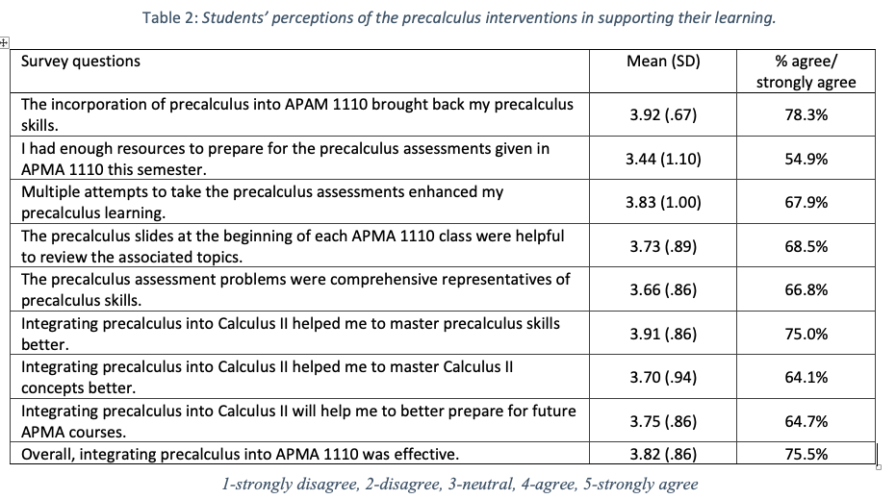
Example Findings : Incorporate Precalculus into Calculus II – Part III
Overall, most students had positive perceptions of the pre-calculus intervention in supporting their learning
>=75% students agreed or strongly agree that the intervention helped them learn pre-calculus concepts and was effective.
More interesting findings can be found in [1]
[1] M. Li, S. Pisano, J. Marley, A. Fernando, and L. Wheeler, “Integrating Precalculus into Calculus II and Its Outcomes”, ASEE, 2024, to appear

Slide 12
Discussions
Any question about this strategy?
How does such strategy apply to your own subject?
Any possible challenges when applying such strategy to your own subject?
Anything else?
Meiqin Li

Slide 13

Thank you
Meiqin Li

