Slide 1
Tips & Tools for Figures
Kelly J Cunningham, PhD; Matthew Korban, PhD; Kelly Dunham
Graduate Writing Lab
School of Engineering & Applied Science, University of Virginia
gradwritinglab@virginia.edu | bit.ly/SEASGWL
This work is CC-BY and must include full citation & DOI. Individual images and examples & materials from other sources are not CC-BY. Blue dino is a GWL icon & not CC-BY.

Slide 2
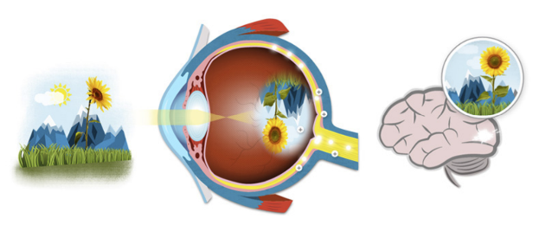


Why Figures
The most visible items in a paper
  Human vision
  Attract readers
Summary of paper
  Visual Abstracts
High quality figures = Professional looking
https://blog.tonkabi.com
https://opmed.doximity.com
https://www.itworldcanada.com
Notes:
matt

Slide 3
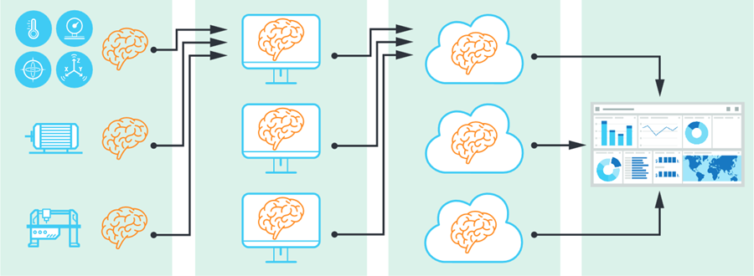

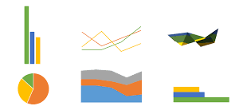
Types of figures
Pipelines
  Method flow
Visualization
  Often implicit representation of results
  Simple and effective
Raw Results
  Explicit visualization of results
https://www.analog.com/
https://www.udacity.com/
https://edu.gcfglobal.org/
Notes:
matt

Slide 4
One key message – Conveyed w/intentional choices
Audience- Who? Expectations?
Context- Paper, presentation, poster; situation, domain
Purpose- What does the figure need to do?
Expectations in technical writing
  Directness/Clarity
  Accuracy
  Precision- dial in to context/audience (journal vs grant)
  Purpose-driven
Notes:
Make your audience work as little as possible to get your content

Slide 5
One key message- Easy or Difficult?
Lamberti, W. F., An Overview of Explainable and Interpretable Artificial Intelligence, In ``AI Assurance: Towards Valid, Explainable, Fair, and Ethical AI'' (To be Published Spring 2022

Slide 6
One key message- Easy or Difficult?
Lamberti, W. F., An Overview of Explainable and Interpretable Artificial Intelligence, In ``AI Assurance: Towards Valid, Explainable, Fair, and Ethical AI'' (To be Published Spring 2022

Slide 7

One key message- Easy or Difficult?
Lamberti, W. F., An Overview of Explainable and Interpretable Artificial Intelligence, In ``AI Assurance: Towards Valid, Explainable, Fair, and Ethical AI'' (To be Published Spring 2022

Slide 8
Simplify when possible
2d vs 3d
Only what is needed to achieve purpose
Accurate clear labels
Use expectations & associations
  Ex. Higher values = up

Slide 9
Paper
Presentation
Poster (print)
CMKY/grayscale
Stands alone
1 clear message
Multipart common
Often scaled down
Journal guide for specs
  Tiff, pdf, svg
RGB
w/spoken explanation
1 quick message
Most simplified
Animation possible
CMYK
Standalone or start convo
Printed at large scale
Readable on 8.5x11”
Vector (svg) or
300 dpi min at size
Notes:
Conventions & constraints
Consider- size, color, expectations, the medium, tech specs

Slide 10
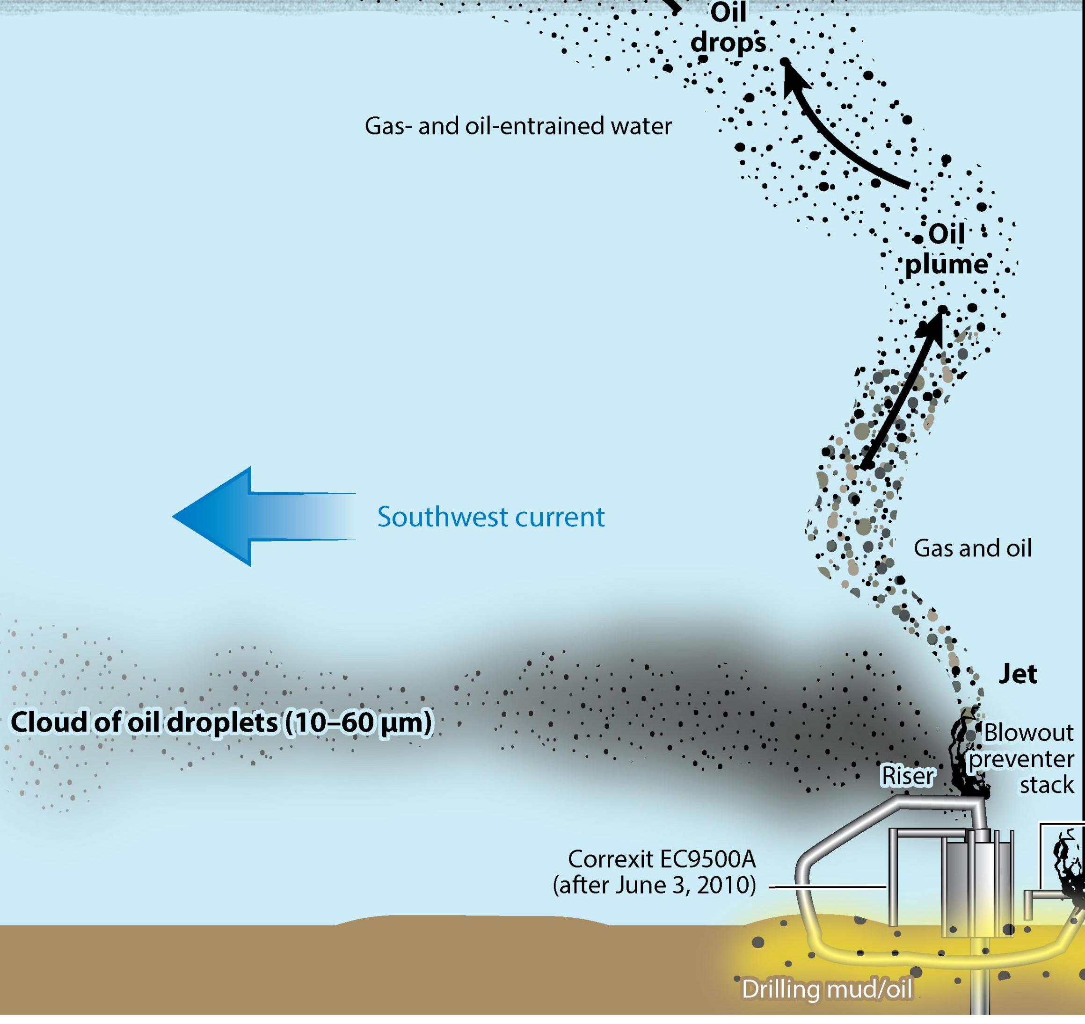
Match to Context & Purpose
Need:
For a presentation
Slide purpose:
Highlight gaps in oil spill clean up
Figure:
Show oil spill spread
From a paper
Shows how oil spills happen under the ocean
King, G. M., Kostka, J. E., Hazen, T. C., & Sobecky, P. A. (2015). Microbial responses to the Deepwater Horizon oil spill: from coastal wetlands to the deep sea. Annual review of marine science, 7, 377-401.

Slide 11
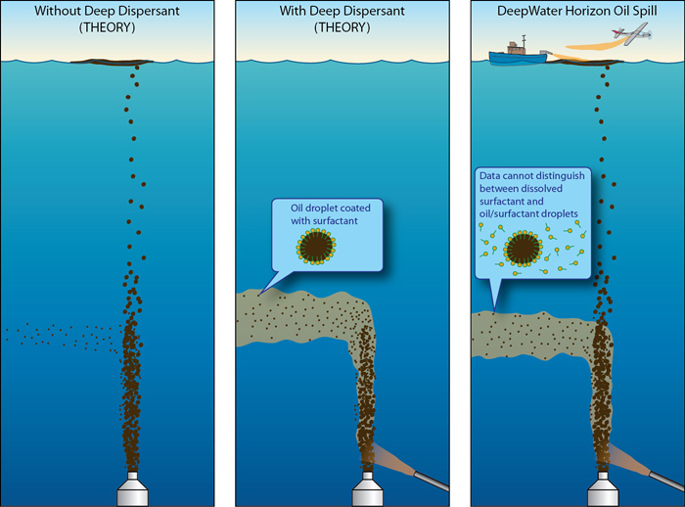
Match to Context & Purpose
Deepwater Horizon Oil Spill
1500 m
King, G. M., Kostka, J. E., Hazen, T. C., & Sobecky, P. A. (2015). Microbial responses to the Deepwater Horizon oil spill: from coastal wetlands to the deep sea. Annual review of marine science, 7, 377-401.
Kujawinski, E. B., Kido Soule, M. C., Valentine, D. L., Boysen, A. K., Longnecker, K., & Redmond, M. C. (2011). Fate of dispersants associated with the Deepwater Horizon oil spill. Environmental science & technology, 45(4), 1298-1306.

Slide 12
Match to Context & Purpose
Simplify
No text
No extraneous info
Focus on purpose
Deepwater Horizon Oil Spill
1500 m
Kujawinski, E. B., Kido Soule, M. C., Valentine, D. L., Boysen, A. K., Longnecker, K., & Redmond, M. C. (2011). Fate of dispersants associated with the Deepwater Horizon oil spill. Environmental science & technology, 45(4), 1298-1306.

Slide 13
Visual Choices & Considerations
Notes:
Like language choices & revision
Visual choices- match to purpose, context, audience
Expect revision

Slide 14
Be intentional
Notes:
(in revisions)

Slide 15
Grouping
Notes:
Gestalt grouping principles, etc.- read up on them for more

Slide 16
Similarity- Size

Slide 17
Similarity- Shape

Slide 18
Similarity- Size & Shape

Slide 19
Similarity: Color Groups before Shape
Notes:
Use this to your advantage to strategically group things by color- headings, variables, highlighting

Slide 20
Enclosure

Slide 21
Proximity
Notes:
Used most in posters

Slide 22
Proximity is enough
Notes:
This means we don’t have to fit everything in boxes- we saw this in examples

Slide 23
Enclosure + Proximity

Slide 24
Enclosure + Proximity
Notes:
Enclosure can be very subtle and work well, modern trend in posters is subtle enclosure if used- not thick bold high contrast lines or big bright boxes- think more thin gray or dashed/dotted lines

Slide 25
Proximity in multipart figures
Notes:
Enclosure can be very subtle and work well, modern trend in posters is subtle enclosure if used- not thick bold high contrast lines or big bright boxes- think more thin gray or dashed/dotted lines

Slide 26
Proximity in multipart figures
Notes:
Enclosure can be very subtle and work well, modern trend in posters is subtle enclosure if used- not thick bold high contrast lines or big bright boxes- think more thin gray or dashed/dotted lines

Slide 27
Color
Notes:
Gestalt grouping principles, etc.- read up on them for more

Slide 28
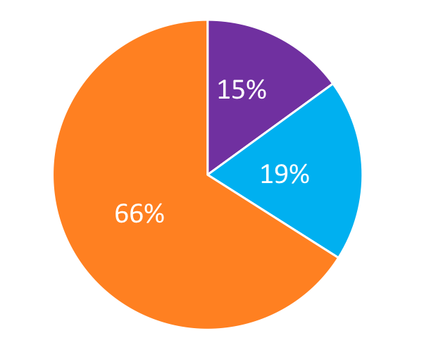
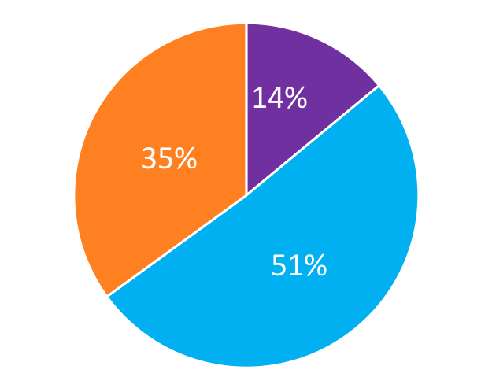
Maintain color for variables or samples
Condition A
Condition B
Notes:
Enables comparison across diff parts of poster
Helps us track a particular variable or sample throughout your research story- think color is designating a character in your story or a characteristic

Slide 29
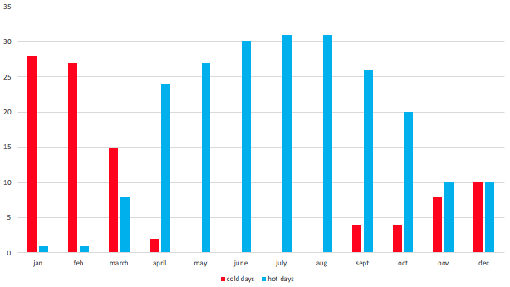
Be mindful of color associations- use them
Notes:
This is a temp chart….

Slide 30
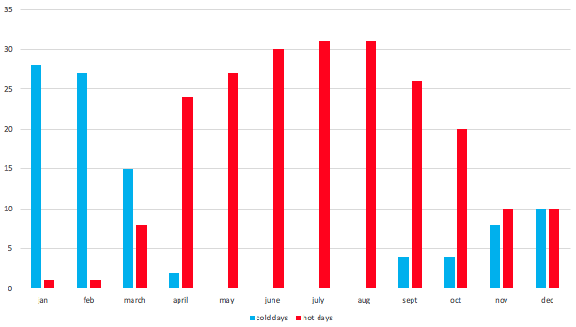
Be mindful of color associations- use them
Notes:
Use what your audience already knows/thinks/associations
Ie. red is hot, blue is cold
Less work to get the message

Slide 31
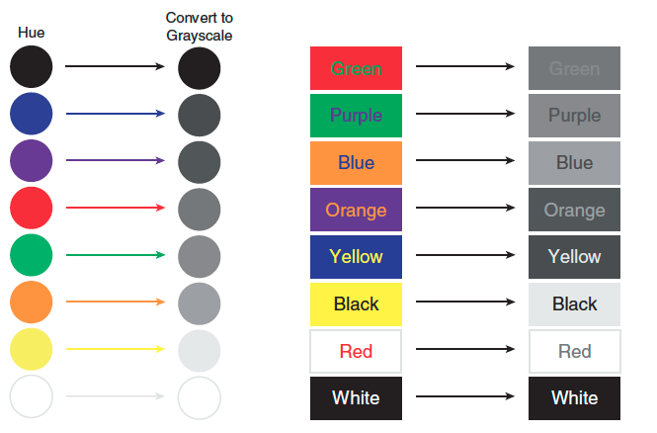
Contrast: Convert Colors to Gray Scale to Check
image from c4 of designing science presentations
Notes:
From c4 of designing science presentations

Slide 32
Choosing colors
Be mindful of constraints
  Contrast- convert to grayscale to check or use a tool (built in accessibility checker, online tools)
  Colorblind friendly palettes
Have an image? Choose colors from it for consistency (eye dropper)
No clue?- use established palettes
  University color palettes – ex. https://brand.virginia.edu
  Color brewer
  Color chooser

Slide 33
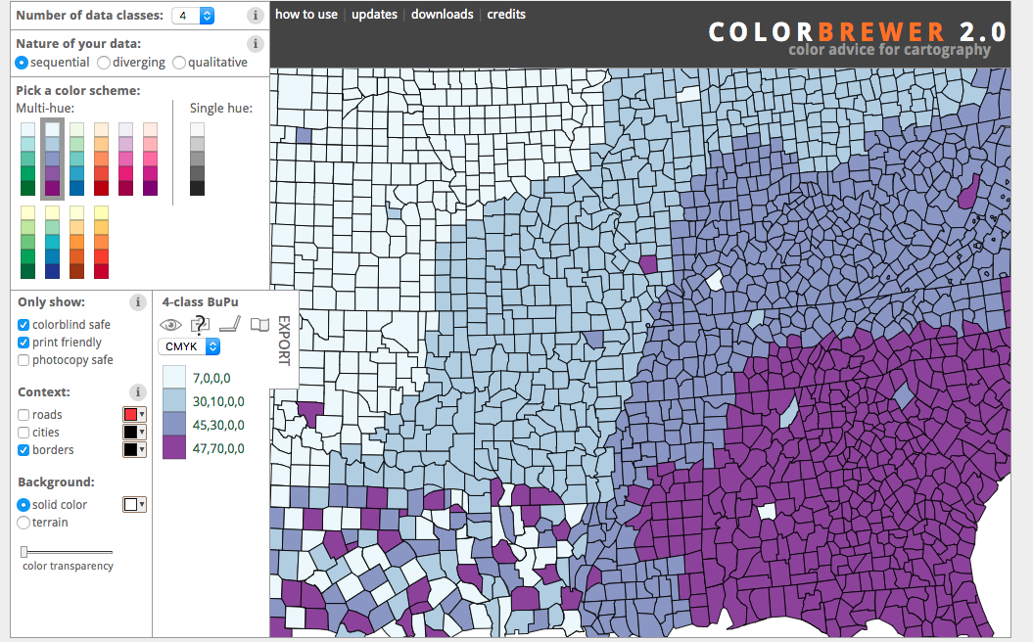
Notes:
Color brewer- use for choosing color palette
Also works w ggplot 2 in R
Other similar tools out there for choosing colors

Slide 34
Tools for Figures

Slide 35
Data Viz & Statistics

Slide 36

R - ggplot2 (free)
Data visualization for R
Based on the Grammar of Graphics
Training & Resources
  Tidyverse/ggplot2 website
  Data Services Library Workshops / HSL Workshops
    Past recordings, slides, resources, & contact
    R intro
    Set up 1on1s

Slide 37
Other software
Excel- quick basic graphs, remember to edit defaults
GraphPad Prism- data, results & graph sections, more options than Excel
Tableau- interactive data displays, dashboards
Discipline/Method specific
  Ex. VosViewer- bibliometrics
*Font Sizes
  Poster vs 3.26” column

Slide 38
Qual Figures,
Procedural Overviews
..

Slide 39
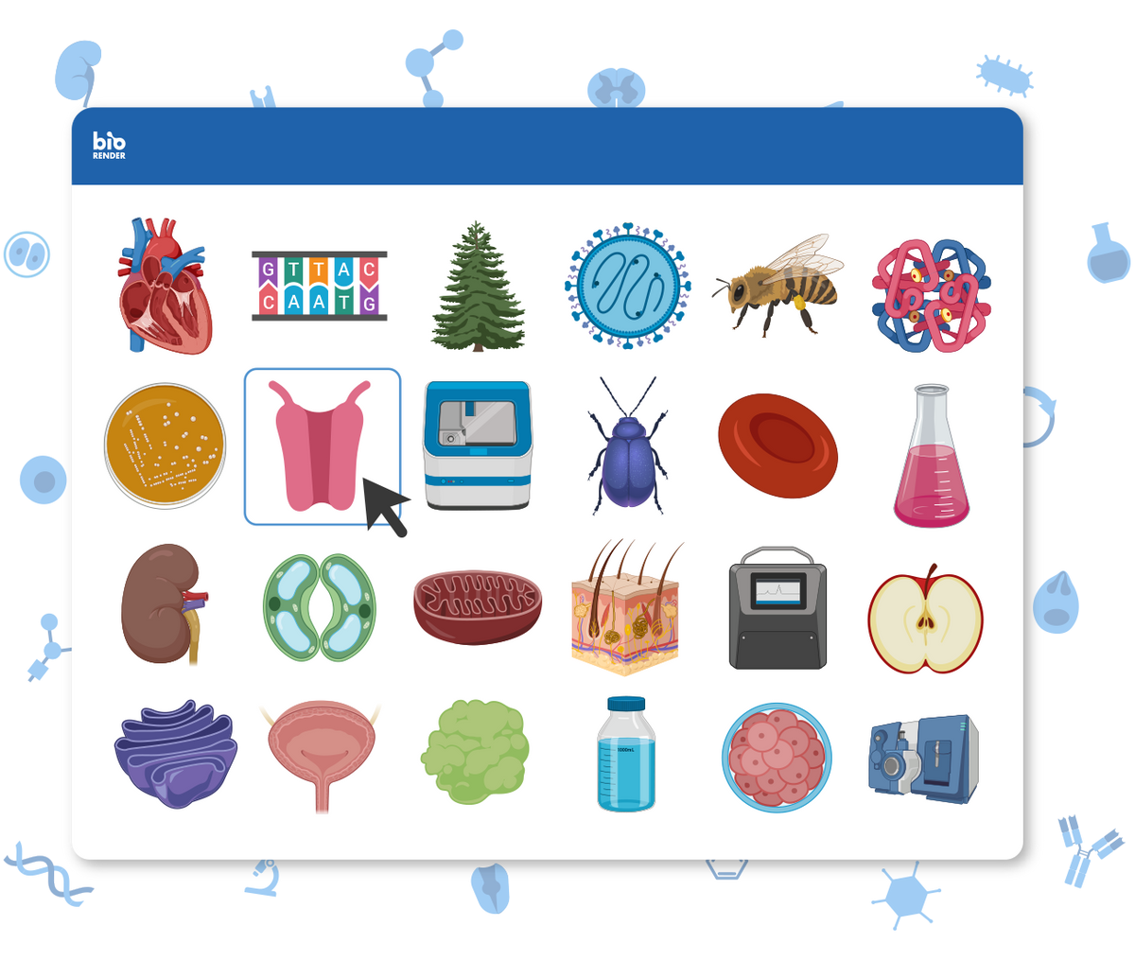
BioRender (free)
Icons
  lab instruments
  biological sciences
5 free templates
Lab License:
  higher resolution figures & more customizable colors

Slide 40
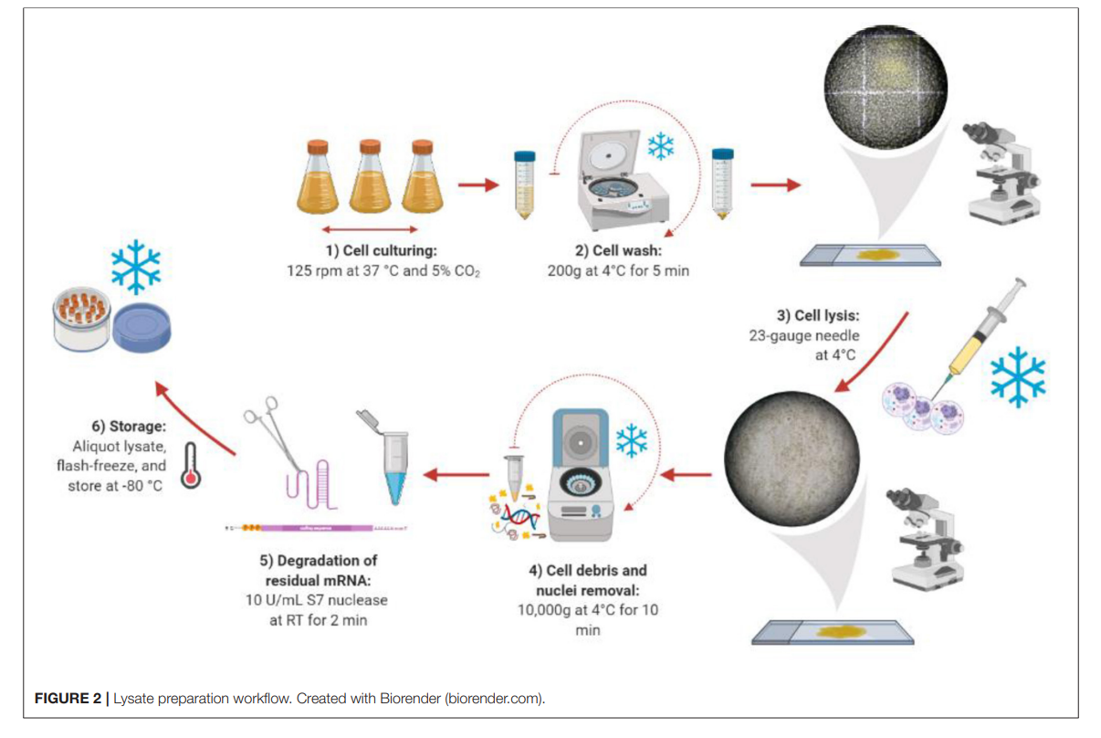
BioRender is great for Experimental Overviews
Heide et al. 2021. Frontiers in Bioengineering and Biotechnology. Design, Development and Optimization of a Functional Mammalian Cell-Free Protein Synthesis Platform. DOI: 10.3389/fbice.2020.604091

Slide 41
BioRender Notes
Unlimited downloads
  Save different versions of figures you use often
  All colors are customizable
Must cite BioRender in the figure caption or acknowledgements section

Slide 42
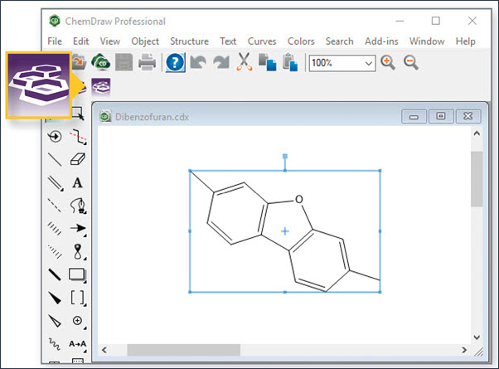
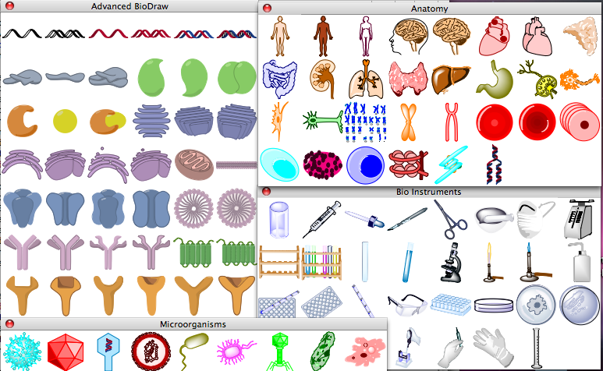
ChemDraw & ChemBioDraw
May have a dept or lab license – contact your Dept’s library liaison

Slide 43


ChemDraw – Tips
Default Structure
ACS-Style Structure
You can change the format of a structure for a specific journal(ACS, Nature, Journal of Molecular Methods, etc.)
Lasso object - > click object in toolbar -> apply object settings from

Slide 44
Figure Design & Editing
..

Slide 45
Vector:
Adobe Illustrator (subscription, some labs have access) (vs Photoshop- pixels); InkScape (Free, limitations)
  Figure creation possible
  Useful for editing figures from other programs
    Extract images, pieces of images (legends, labels, points etc)
    Can edit colors, labels, move pieces, etc. of figures created elsewhere
PPT Tips
  Figure creation- flow charts etc
  Figure editing (save as image, remove background/set transparent color, etc.)
  See also ppt tips slides

Slide 46
Vector: Adobe Illustrator
Image format
  Vector Graphics vs Bitmap
Advantages
  Creating images/figures from scratch
  Flexibility
    Revise figure modules: shape and colors
    Import/export figure modules

Slide 47
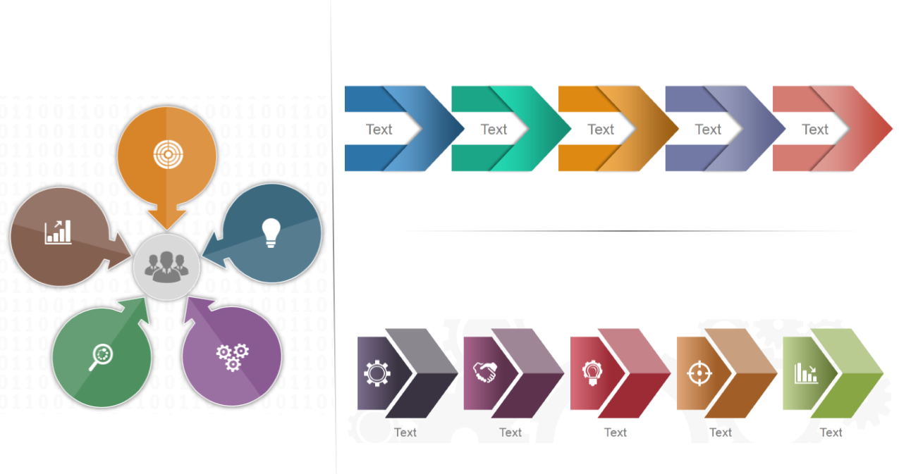



Microsoft PowerPoint (PPT)
Why PPT
  Variety of tools
    Different shapes, editing tools and effects
  Using existing assets
    Easy to import/export figure modules
  Easy link to other Microsoft products
    Microsoft Excel: import data/charts
    Microsoft Word: import/export figures from/to papers

Slide 48
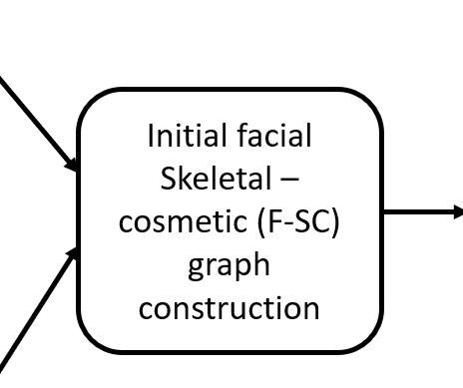
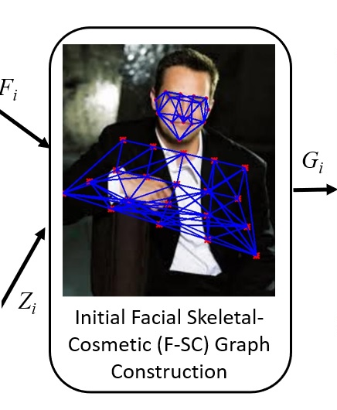
Figure Creation in PPT
Pipeline Figures
  Starting with a simple template
    Figure Modules: Simple shapes and colors
  Adding more details
    Figure modules: more details to better represent the method
      Using professional tools
      Adding effects
  Revision
    Correction of modules

Slide 49
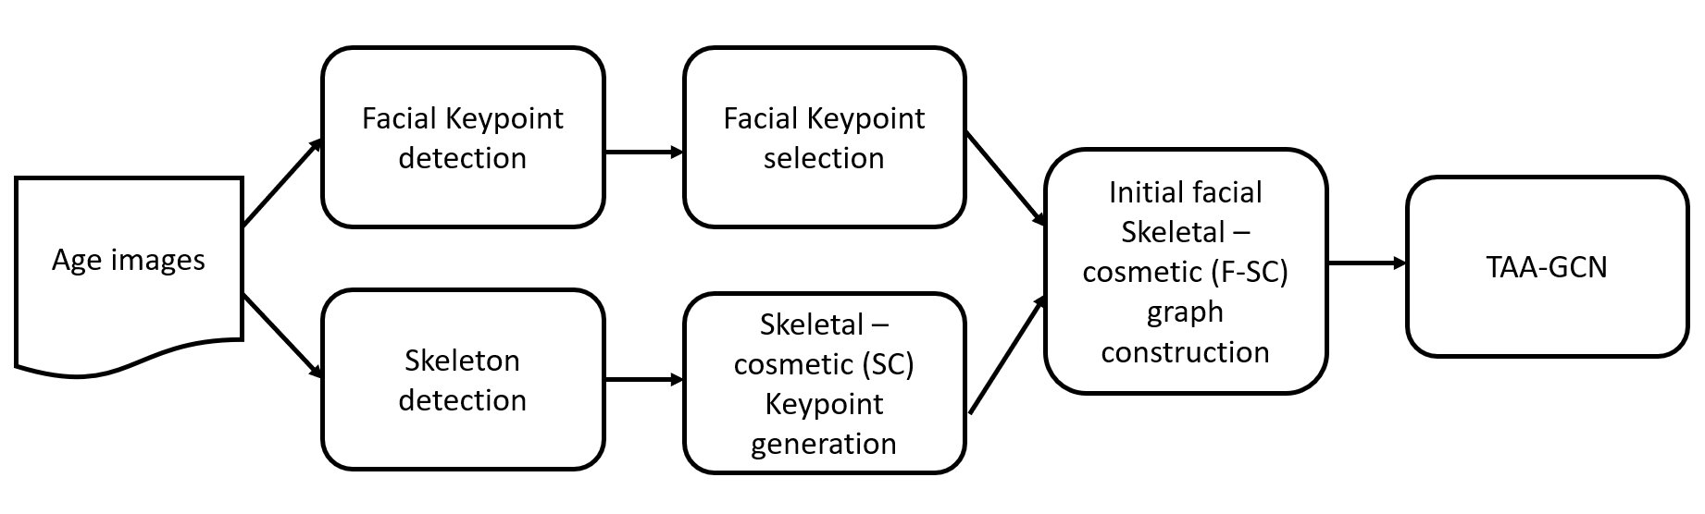
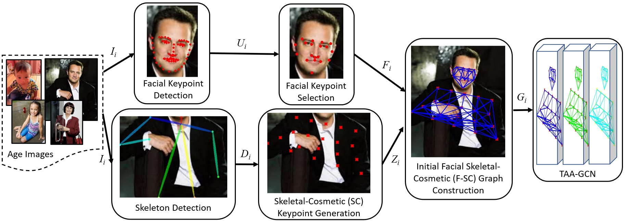
Figure Creation in PPT - Examples
Start with Simple template
Adding more details
    Parameters
    Images
    Editing and Effects
Revision
    Correcting existing modules

Slide 50
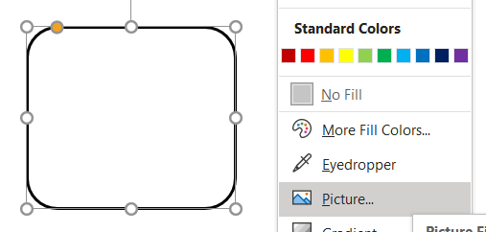
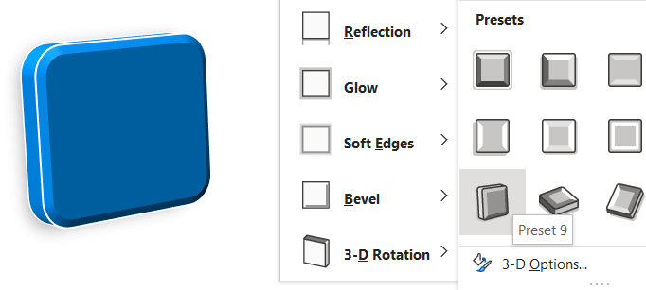
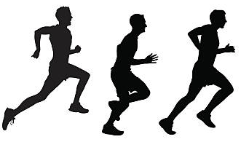
PPT Editing Tools and Effects
Starting with a shape
Effects
  Shapes
  Colors
Background Removal
shape effect
color effects

Slide 51
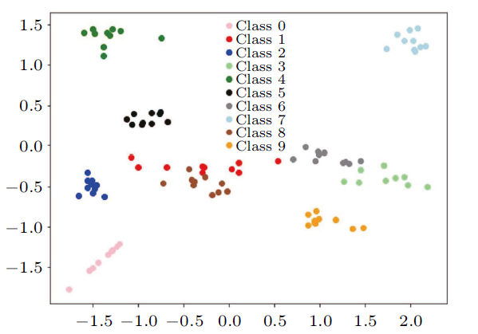
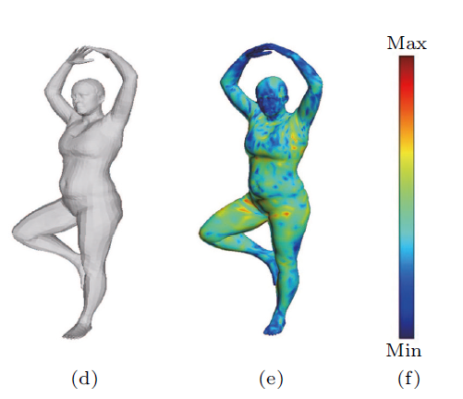
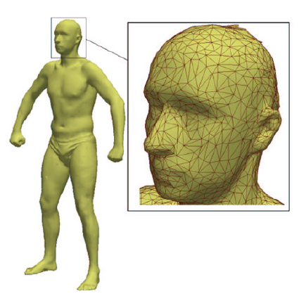
Visualization
Simple and Effective
  Simplifying the results
  Different colors and markers
Emphasizing important results

Slide 52
Going forward
..

Slide 53
Revise & Revise Again
Get feedback
  Pencil/white board sketch to last versions
  Multiple audiences- lab, engr, PRG, friends, advisor, etc.
What key message do they understand from the figure alone?
  How quickly & easily?

Slide 54
Remember
1 Key message
Standalone
Match to
  Audience
  Context
  Purpose
Make intentional design choices
Simplify when possible

Slide 55
Additional Resources

Slide 56
Resources- Data Visualization, Software, & Presentations
Data Services Library Workshops / HSL Workshops
    Past recordings, slides, resources, & contact
    Data viz, software training (R, Tableau, Excel, etc.)
    1on1s & email help with software
DESIGNING SCIENCE PRESENTATIONS: A VISUAL GUIDE TO FIGURES, PAPERS, SLIDES, POSTERS AND MORE (Carter 2013)- ebook, online access via UVA
SLIDE RULES: DESIGN, BUILD, AND ARCHIVE PRESENTATIONS IN THE ENGINEERING AND TECHNICAL FIELDS IEEE Professional Communication Series book; get free online access to the ebook with your UVA login
Trees, Maps, & Theorems: Effective Communication for Rational Minds- Doumont (2009), book <recc from Amy Clobes>
MIT COMMKITs
SARC 5400: Data Visualization

Slide 57
Resources- general figures
General Figure Resources
What types of data goes in a figure? What goes in a table? (https://writingcenter.unc.edu/tips-and-tools/figures-and-charts/)
More information on paper vs. talk vs. poster figures and why they are different (http://cachestocaches.com/2020/1/talk-figures-are-different-paper-figures/)
Accessibility checkers & tools form UVA – color/contrast, alt text, guides, checkers, etc. Also has a section specific to STEM fields

Slide 58
Resources- Excel
Numerical Data Stats & Graphs Resources
Microsoft office UVA download (https://virginia.service-now.com/its/?id=itsweb_kb_article&sys_id=d36122f9db719740f032f1f51d9619f2#students)
Excel Analysis ToolPak Add-on (https://support.microsoft.com/en-us/office/load-the-analysis-toolpak-in-excel-6a63e598-cd6d-42e3-9317-6b40ba1a66b4)
How to make default Excel graphs look better (https://www.mbaexcel.com/excel/how-to-make-your-excel-line-chart-look-better)
Also look for HSL Excel bites workshop series

Slide 59
More Resource Links
File converter:
https://sourceforge.net/projects/bulkimageconver/
File converter that supports eps:
https://converseen.fasterland.net/

Slide 60
Additional resources
Book: Designing Science Presentations: A Visual Guide to Figures, Papers, Slides, Posters and More (Carter 2013) ONLINE ACCESS VIA UVA
HOW TO IMPROVE THE PRESENTATION SKILLS OF PHD STUDENTS A detailed and practical post on NextScientist on improving your presentation skills as a PhD student
20 TIPS FOR TOP ACADEMIC PRESENTATIONS
SLIDE RULES: DESIGN, BUILD, AND ARCHIVE PRESENTATIONS IN THE ENGINEERING AND TECHNICAL FIELDS IEEE Professional Communication Series book;

Slide 61
PRESENTING YOUR RESEARCH (FRIEDMAN, 2016)
PRESENTING WITH SLIDES video from Texas A&M's University Writing Center
INFORMATION VISUALIZATION available for free as an ebook through UVA library, technical reference, learn more about vizualization principles
FREE SOFTWARE FOR BIOLOGISTS PART 3- PREPARING FIGURES Overview of some free software for scientific visualizations including options for figures, diagrams and animations
Library WORKSHOPS ON DATA VIZUALIZATION TOOLS
DATA VISUALIZATION & DESIGN TEMPLATE links from Rice (scroll down)
https://engineering.virginia.edu/current-students/current-graduate-students/graduate-writing-lab/events/graduate-writing-lab-visual (to be updated)

